Slide 1
The CCS Migration to SERA
ERA Conference, 23. April 2024

Slide 2
“Migration”
Moving from current/legacy systems into the Migration Targets
In the end, migration is daily business for railways when introducing new market product today and integrate it locally
System Pillar defining a set of recommendations and best practices
National “adaptation” developments
”Adaptation” always happens by adapting the national legacy system to a standard interface or to harmonized operational rules
National
Product
Usage
National
Architecture
National
bespoke
products
National migration plan: When to use which product
European
Product
Development
Harmonized
Target
Architecture
Available European products for Migration Target 1
Available European products for Migration Target 2

Slide 3
Migration Target 1 (current discussion state)
Title: First set of solutions largely based on today’s technology
Timing: Starting from 2030
Available Products:
  Harmonized Trackside Protection System
  EULYNX based object controllers for trackside assets (available earlier)
  First modularisation and upgradeability for new CCS onboards
  FRMCS (available earlier)
  Trackside digital registry
  FDFTO/DAC, automated digital coupler
  Based on
    Operational harmonisation for ETCS Level 2 only
    Harmonized Cybersecurity
  Optional: TMS using harmonized interfaces, harmonized GoA2 products.

Slide 4
Migration Target 2 (current discussion state)
Title: Enhanced digitalization introducing new technology
Timing: Starting from 2035
Available Products:
  Full modular CCS onboard architecture for new CCS onboards
  Digital registry connected to all trackside systems
  All systems of the target architecture based on End-to-end security
Optional products:
  Remote Train Operation (RTO)
  Advanced safe train positioning
  Advanced DAC/FDFTO

Slide 5
Migration Target A (current discussion state)
Title: Automated European Railway
Timing: Independent. Application in specific areas.
Available Products:
  FRMCS-only CCS trackside/onboard
  ATO GoA 3/4
  Digital register share for all applications, incl. onboard

Slide 6
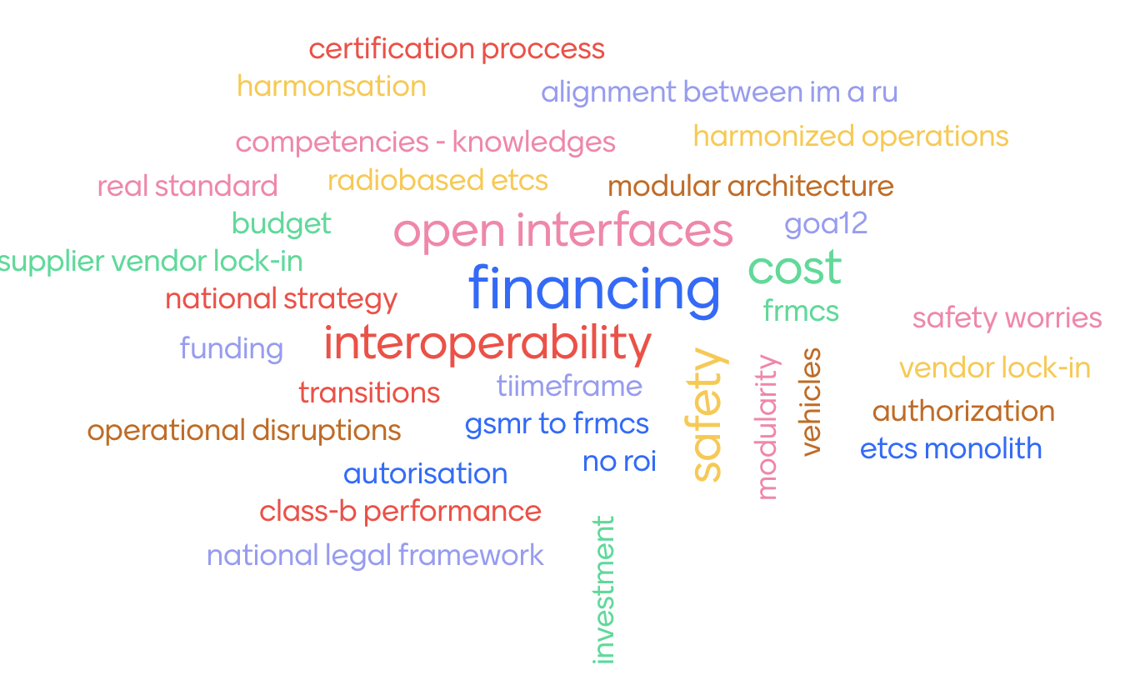

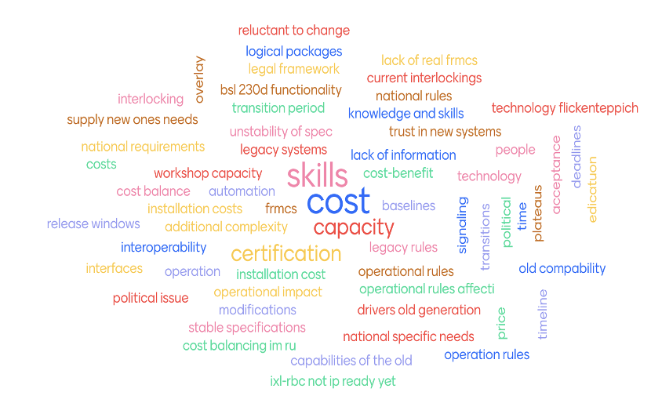
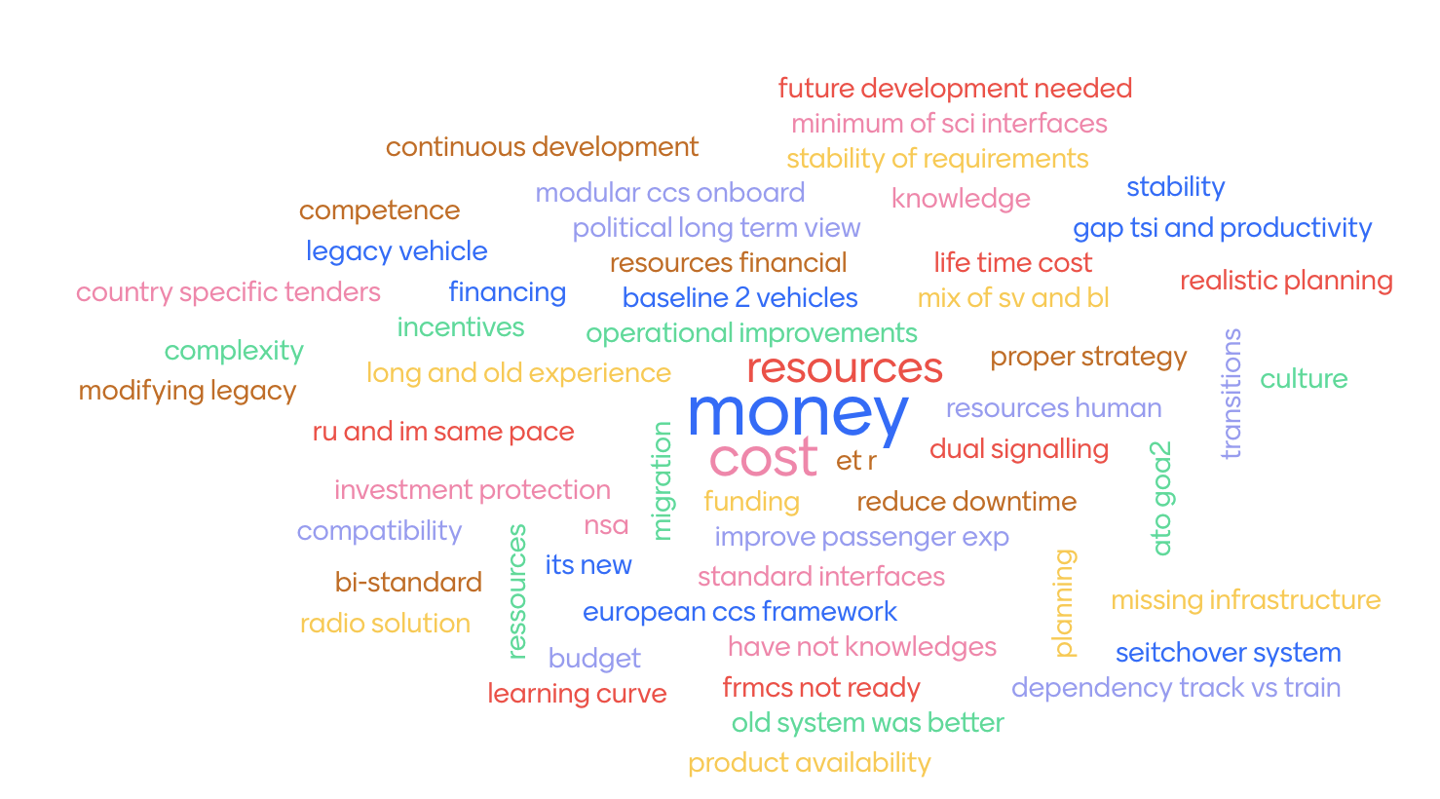
Voting

Slide 7
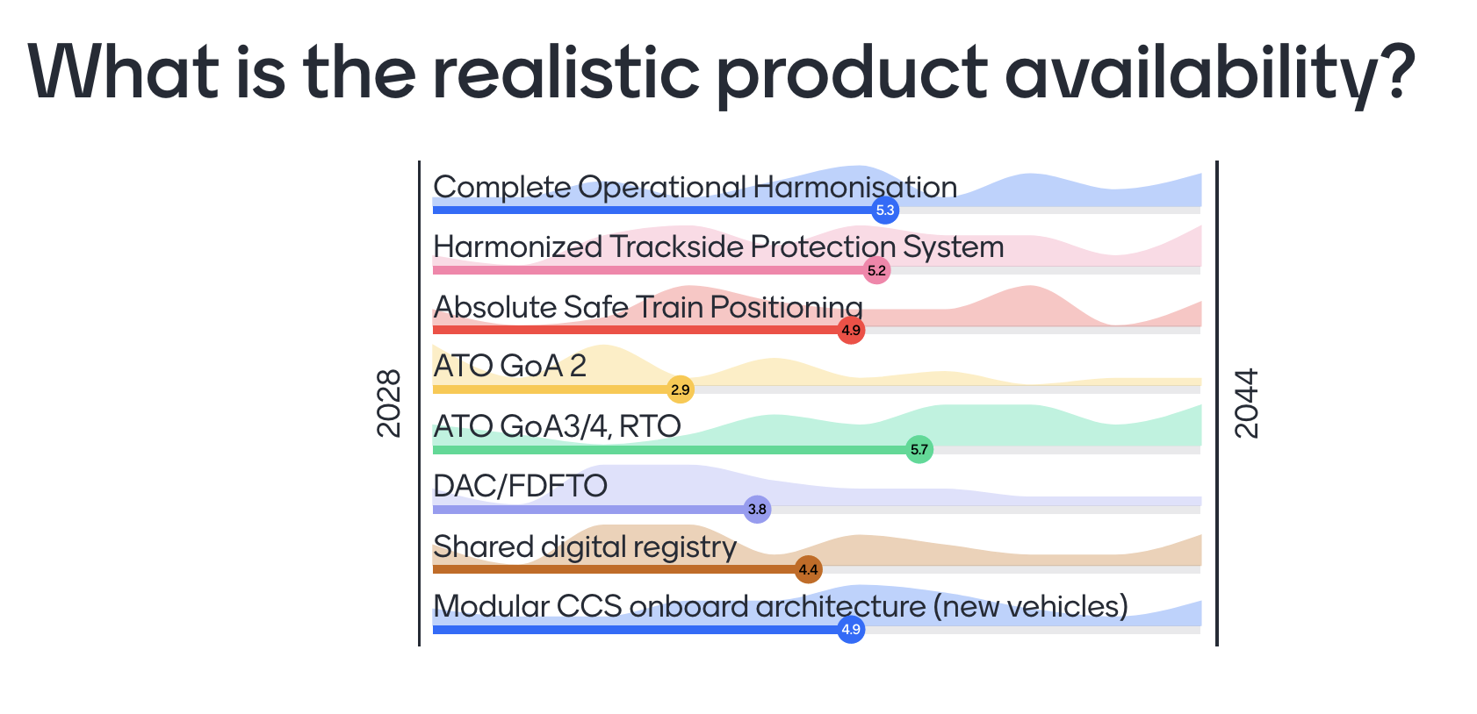
Voting

Slide 8
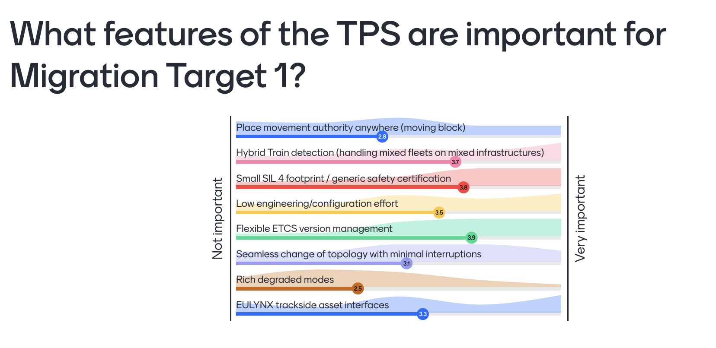
Voting: CCS trackside migration

Slide 9
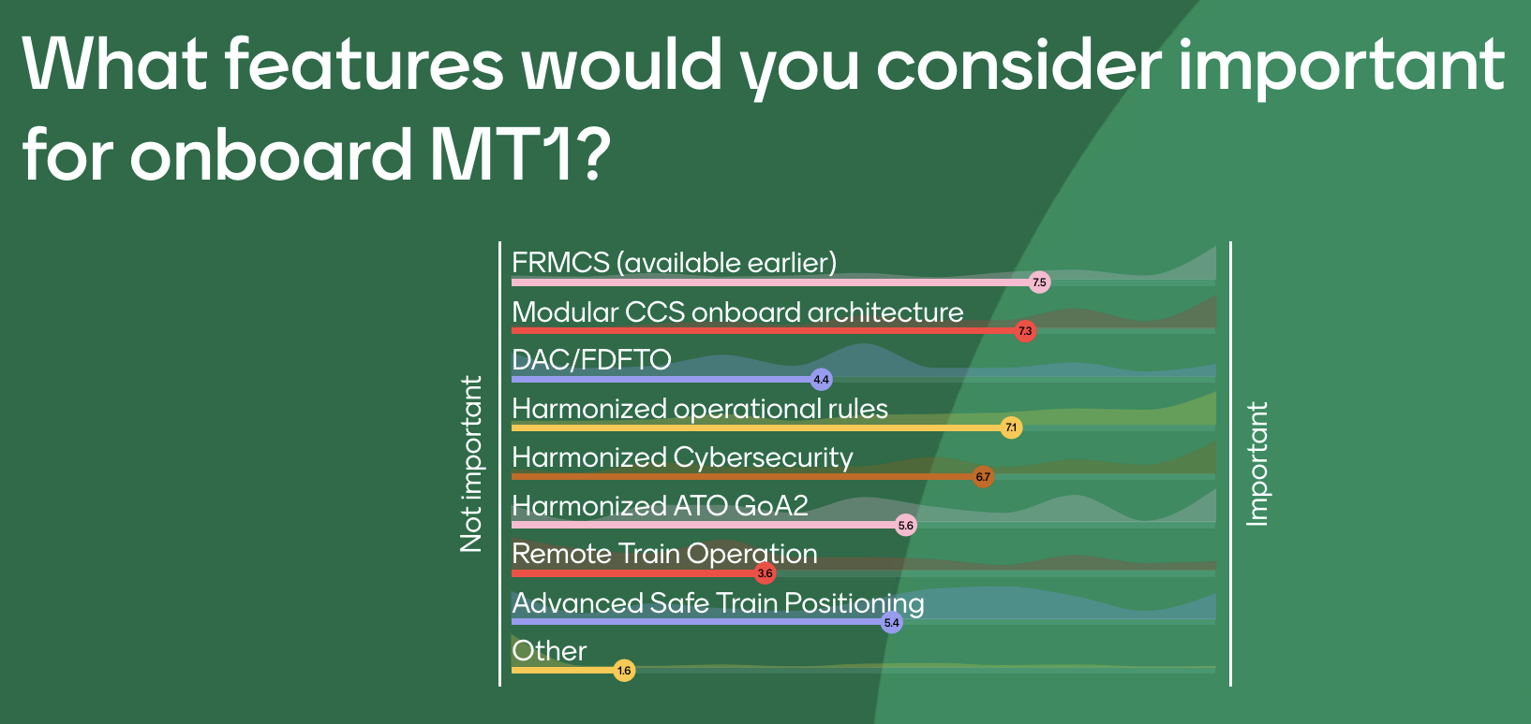
Voting: CCS onboard migration

Slide 10
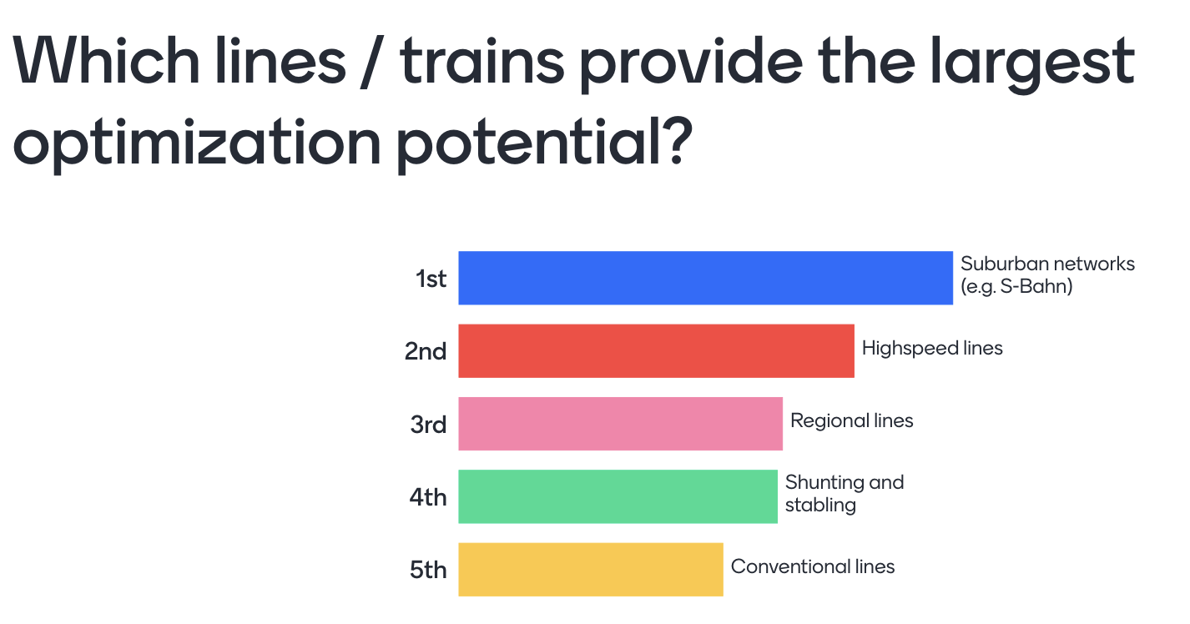
Voting: ATO GoA 3/4

