Slide 1
Railways are linked – so why aren’t rail data linked ?
The mystery of El Ariwi
Dr. Ir. Bob Janssen
ijzerweg.nl
Notes:
You may wonder whether El-Ariwi is a 14th century poet from El Andalus. Sorry, it’s not even arabic. In fact, it’s an abbreviation

Slide 2
El Ariwi is not a person but a symptom
ElementAnfangsRIchtungsWInkel
Defined in a 140 page document.
Mystery solved ?
Application centricity disease
Cryptic name inherited from ancient database design
1990’s: “we’ve got MSAccess – get me a quick result”
The name has stuck ever since
Is there more I should know ?
150+ variables spread over 27 tables.
And that’s only for Germany
ELARIWI is the name of a field in a geo-database
Trouble
Finding and understanding context is hard is hard work
Imagine building a railway application for the whole EU that includes geographic information
Notes:
ELARIWI is short for Elementanfangsrichtungswinkel, the value of the bearing, i.e. angle with respect to north, of a section of track. Finding out it’s meaning is involved because you first need to get your hands on the PDF where the definitions are hiding.
This odd name is only one symptom of this disease that holds back efficient use of information. Back in the 90’s (or even earlier ?), a project was launched to automate the handling of geodetic data and they needed a quick result with the data and tools then available. We’ve carried along the consequences ever since.
And ELARIWI is only one parameter in a long list of concepts that you need to know when working with rail data. And that’s only for one country. Multiply the effort for understanding one parameter by 150 x 27 and you get a feeling for the amount of work it takes to only begin estimating the effort it takes to get a grasp. That’s before building a new application.

Slide 3
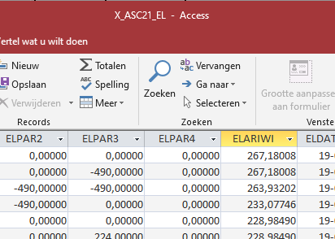
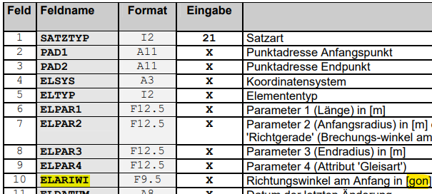
ELARIWI = 267,18 is data but not information
Context turns data into information
In databases
Man and machine need context
Tying context to data is hard work
Information is hiding
In documents and plans
In the minds of experts - the ones about to retire
Application first
Implies creating data that fit the tool
Après le projet le déluge but our KPI are ok
Information revolves around tools
Concepts are mangled and dispersed to fit applications
Notes:
267,18 doesn’t tell you what the units are (400 gon), what track, position on earth, which line, which mapping projection, history and quality of the measure. A number is like understanding the world looking through a straw. It’s the meta-information that lets one put data in context and turn it into information. But in the shown setting, it’s hard work.
Historically and gradually, experts were given tools, typically the latest hype, to help automate their work. The need for a quick win forced them to put the data into the tools the way they could – back then. We’re suffering the consequences to this day.
Hidden information is costly and dangerous. Hiding places are data bases such as MSAccess but also paper plans and pdf documents. Worst case, old hands have the context information in their minds but this is lost when they retire.

Slide 4
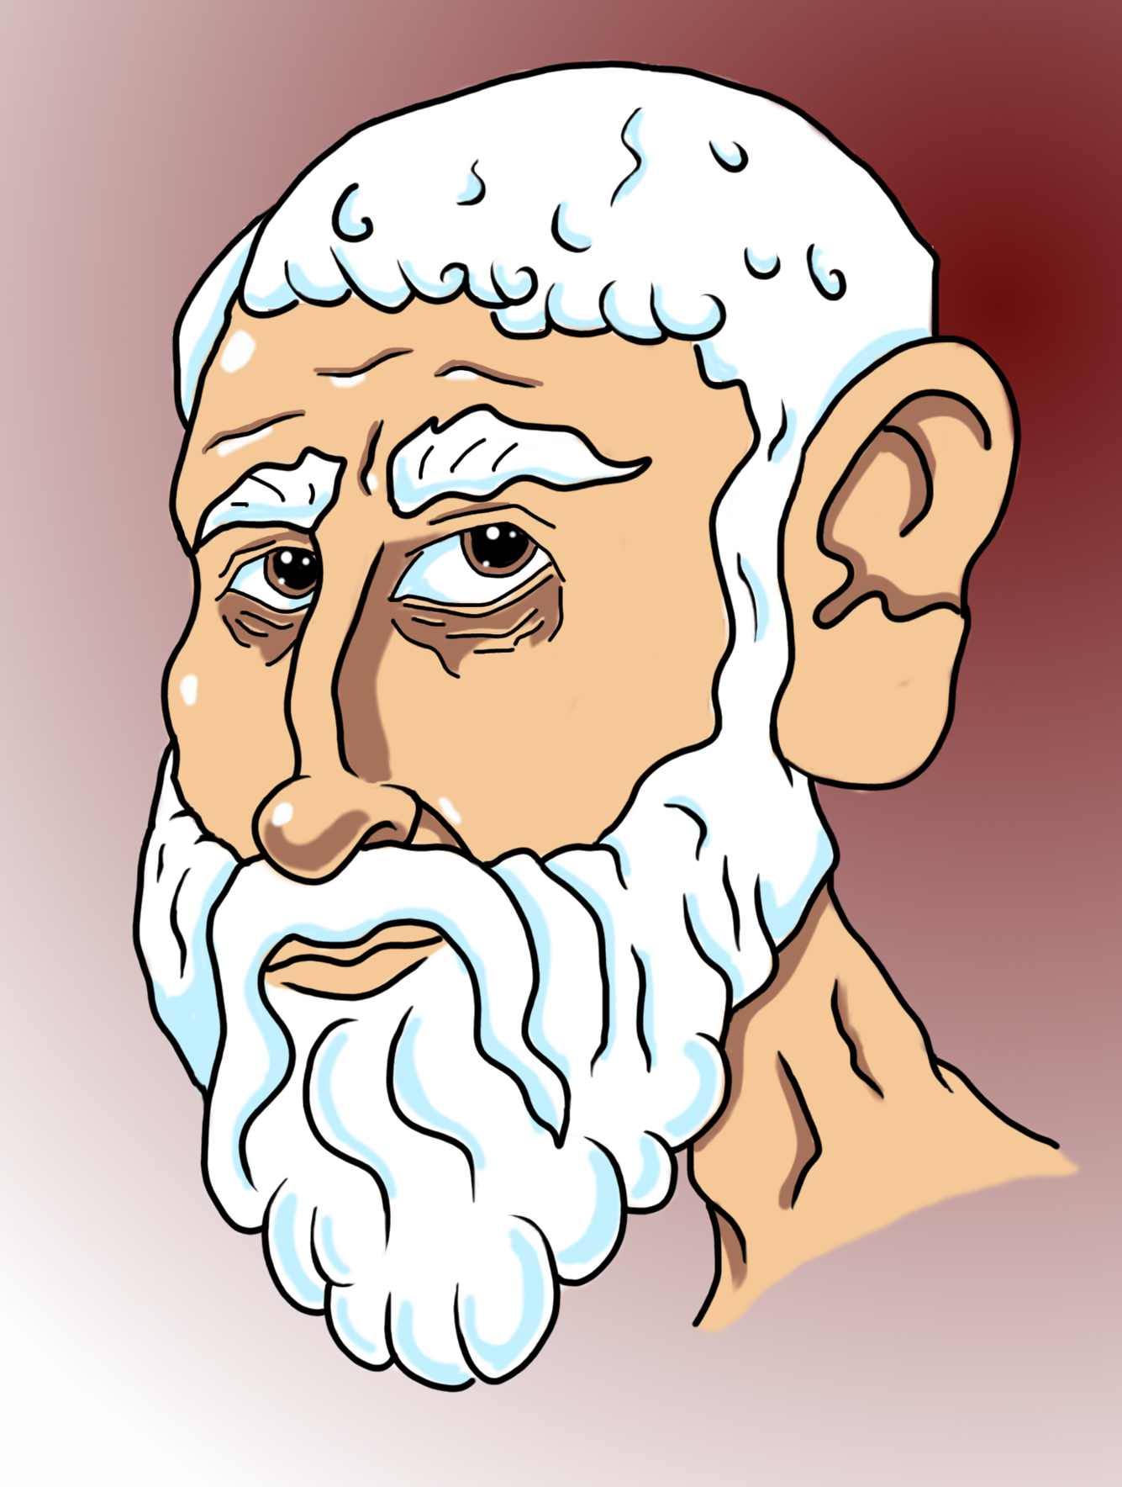
How to improve things
Ancient news from the Information Liberation Front
How to record knowledge
Paint by words
Publish the FAIR story
Not application in sight!
How concepts relate
Identify concepts
Explain concepts
Draw me a sketch
Put things into words
Write it down
Tell the story in subject – predicate – object phrases
Jargon is good – most of the time
Findable
Accessible
Interoperable
Reusable
Not until we know what we’re talking about
Told you so
Notes:
Look at the bright side of things. People have long known how to capture know-how. The diagram on this page gives a lot more context to a human reader. Let’s walk through the mental process of picking up the concepts, explaining and relating them. The infamous ELARIWI is in the middle but we instantly see what it means. Same as bearing and equivalent to azimuth. We can get translate domain expertise into words.
A sketch helps people organise thought and lets domain experts talk with modelling experts. Jargon is mostly good because jargon is domain language. In other words jargon are domain concepts which help man and machine communicate efficiently. Relations between concepts creates a web of understanding and this mimicks the way people learn to understand; understanding starts by labelling things and putting them in the right boxes.

Slide 5
Ceci n’est pas une pipe
A subset of information
It’s a signal - example of capturing knowledge
object
Taxonomy and composition
predicate
subject
Information is a web of concepts
Connect the dots
Close to language models, artificial reasoning and intelligence
Similar to mind mapping
Read along the arrows
Follow your nose
No application in sight
But we begin to know what we’re talking about
Gentle learning curve
Notes:
“I know a signal when I see one” just isn’t good enough. You can’t explain that to a computer – or an AI for that matter. A signal is a subject of the subject-predicate-object phrase “signal shows message”. And object of the phrase “sein is equivalent to signal”

Slide 6
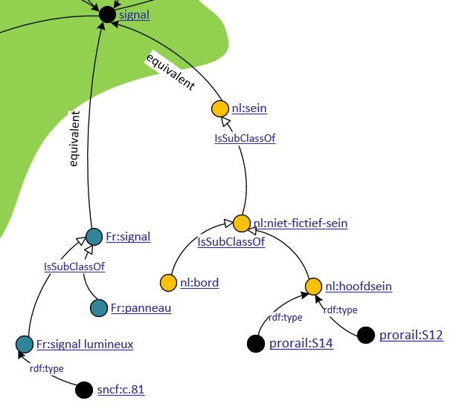
FAIR data have a home
By the way, this represents Linked Data
Findable – Accessible – Interoperable - Reusable
What about real kit
Sncf:c.81 is a french signal lumineux
Still no application in sight
is an instance of the class
Home is where ..
The URI takes you
Nearly there !
Notes:
Having definitions of classes is all well. What about objects, that’s to say real signals. Ideally a click on the link takes me to a website where I find more information about this particular signal c.81 or s14.

Slide 7
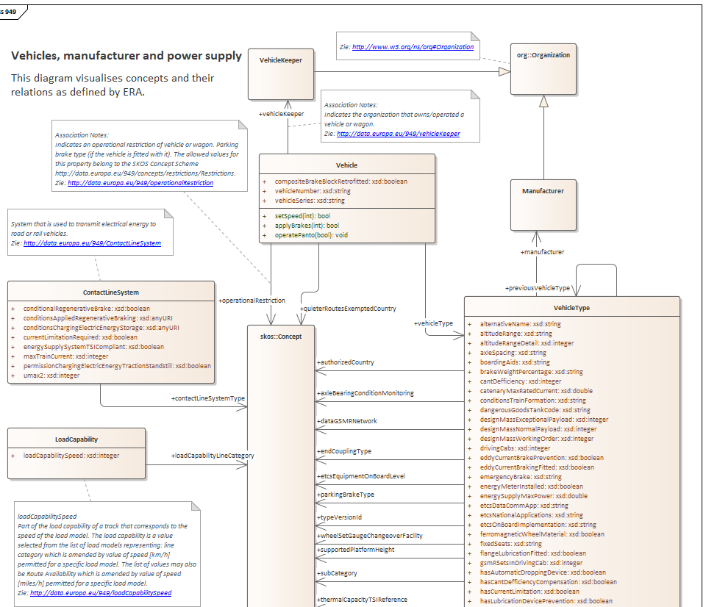
Some prefer UML
Grab
Understand
Expand
Develop
http://data.europa.eu/949
Create class diagrams for a view
Specialise and retain conformity
Add methods to make the model live
Create apps around the data
Read the notes in context
EA AddOn reads RDF triples
Add methods for action
Notes:
System engineers and developers traditionally prefer UML to represent information and context. The fact that ontologies and Linked Data come as triples doesn’t prevent them from working in a well-known tool such as Sparx Enterprise Architect. In fact, many ontologists develop models in UML because it helps to master complexity. The EA tool can import triples, using an AddOn, and users can create views of the classes like the one in this diagram. This view is a subset of the ERA ontology selected to let users focus on their area of interest. Creating such diagrams feels like being locked overnight in a sweet shop. Just pick and mix whatever you need. The diagrams cut out the desired context and mask the unneeded parts.
Software developers can expand the model by specialising classes that inherit properties from the model. This enriches the original model. This doesn’t change the original but adds useful features. One can add methods to the classes that create behaviour. In this example, methods were added to set the speed, apply the brakes and operate the pantograph.
Once enriched, one can turn the UML into code like Java, C#, Python or static stuff like XSD or Json. Only now do applications draw nearer.

Slide 8
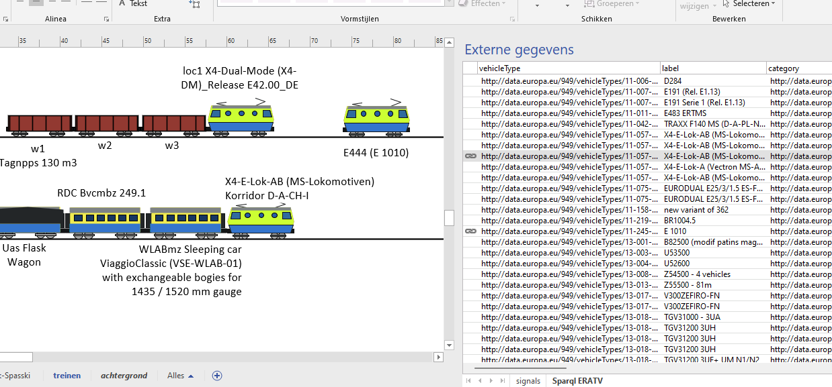
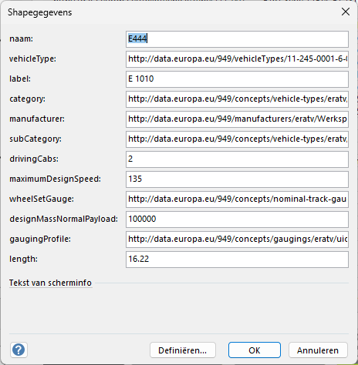
Low Code development
At last an application !
Use case
Build a train consist from ERATV
Query ERATV
Visualise
Retrieve data
Shapes are instances
MSOffice tooling
Drag-and-drop records on drawing
Mastershapes are classes
Shape-data map to records
Vehicle data queried from ERA site
Drag and drop
Double click
Notes:
Here’s an example of a simple application with an absolute minimum of code. MS Visio is good at visualising Business Information (BI) and can connect to external data. In this example, I demonstrate how I can use Visio as an Off-the-shelf tool to “build” a train from vehicle types that are exposed on the ERA site.
I started by writing a very simple sparql query, the query language for linked data, and import the “external data” into Visio. The code is limited to a few lines of sparql.
Then, one can drag and drop records in this data set on the drawing. I have a stencil with mastershapes for vehicles and when I drop a record on the drawing, Visio automatically creates a shape that instantiates a mastershape from a stencil and links the shape to the record. Double-click the locomotive to see the properties. In this way I can build a train in a matter of seconds.

Slide 9
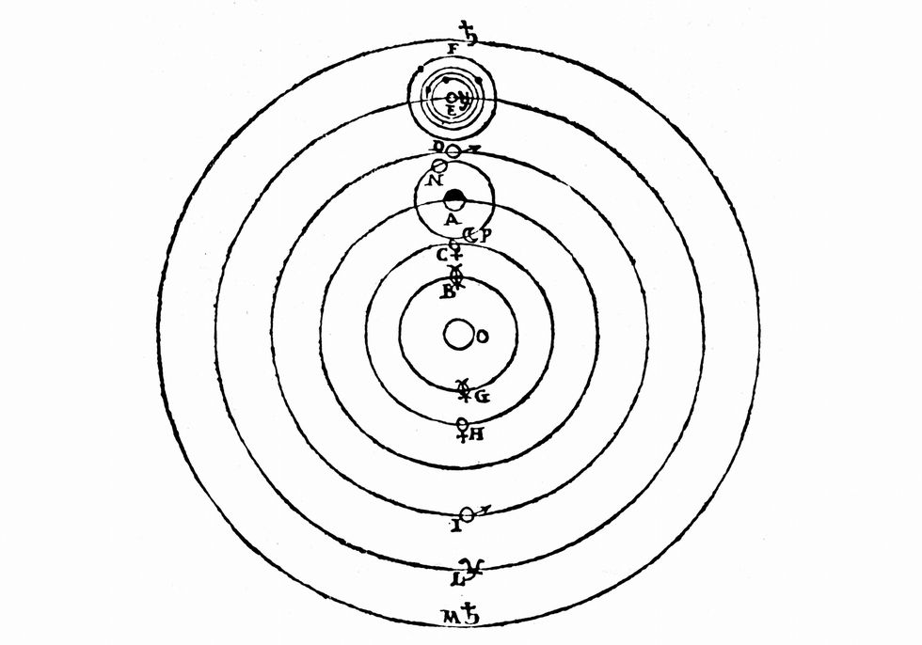
conclusions
E pur si muove
Oracle
MSAccess
Information is …
Legacy applications …
FAIR information …
Modern applications …
Data revolves around applications
Information is hard to get
A web of concepts + meaning + context
Saves effort – certainly mid/long term
Should revolve around FAIR information
Low code/Low maintenance/Easy change
Ideally without application-smell
Requires upfront investment
Built on the shoulders of ancient giants
Java
C#
XSD
Linux
RDF
Python
MSOffice
Json
Applications should revolve around information
More linked stuff at ijzerweg.nl
Notes:
And yet it moves. We’ve seen that information is a web of concepts linked to meaning and to other concepts. Just like the way people think, talk and record knowledge. Language and concepts first is the opposite of applications first. The dire consequences of putting applications first is that information is mangled by the needs of these apps, knowledge is frozen in time and inaccessible.
FAIR information is by design easy to get, ideally through a click of the mouse. So it’s a big saving in terms of effort by IT developers who need to collate know-how that used to be hidden away in silo’s. Compiling the web of concepts requires some upfront effort but pays back handsomely.
Some people object to linked data as “new-fangled, unproven and academic” but the ideas behind LD go back to Plato – how’s that for proven technology ?
Building applications is child’s play compared to trying to dig data out of silo’s. Short, applications that revolve around Linked Data, RDF, are easy to build and maintain because the part that extracts information from the web needs very little code.

