Slide 1
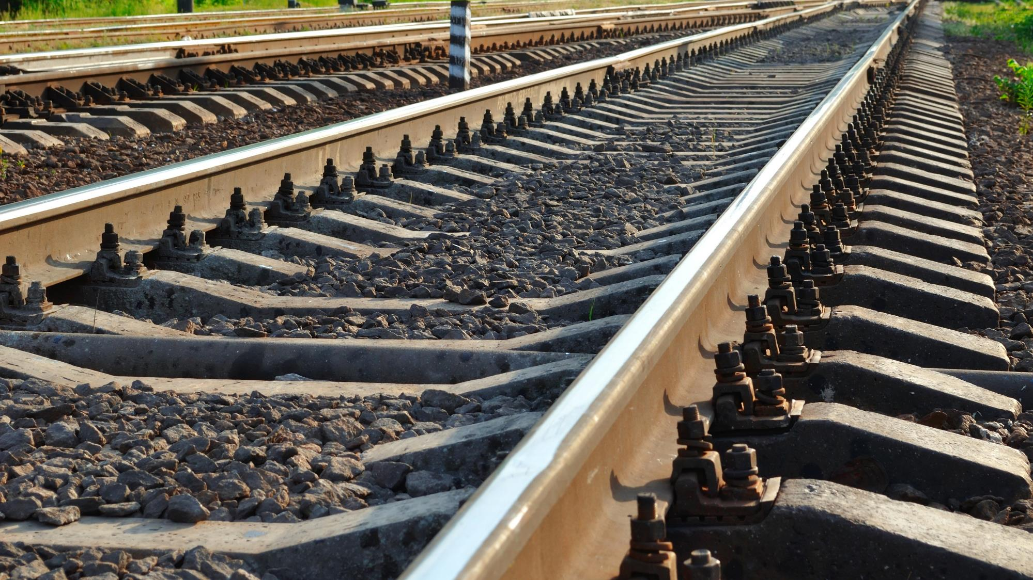

Railway
Interoperability
Ontology
Railway Ontology
Where data and railway infrastructure meet
Rail Data Forum 2024
Dragos Patru
Photo: Adobe Srock / by Tarasylo

Slide 2
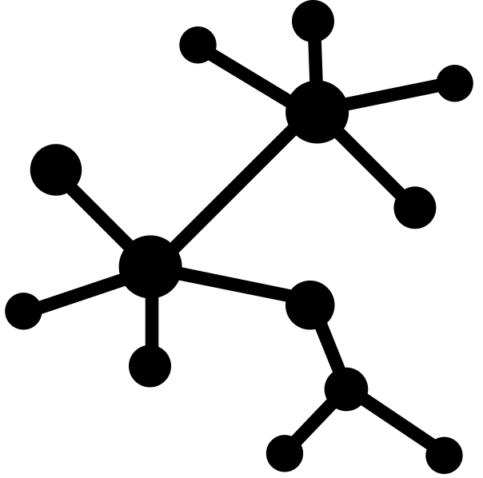
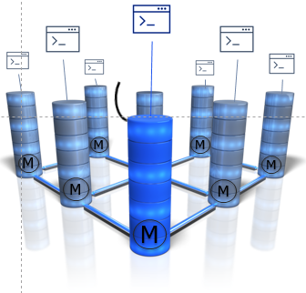
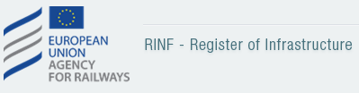

The Journey towards Data Centricity
2019
2021
2022
2024
Management Board Linked Data Mainstream Decision
Railway Organisation Data *
Vehicle Authorization Data *
Siloed data bases /registers
Around 12 DBs application oriented
Connected into Linked Data

Slide 3
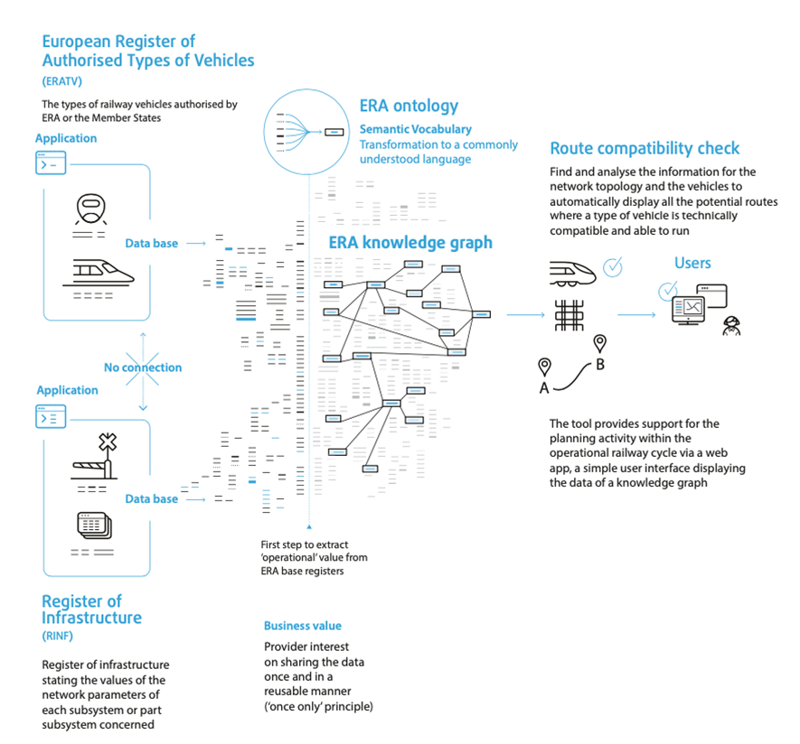
A successful PoC – A Real-world Use Case

Slide 4
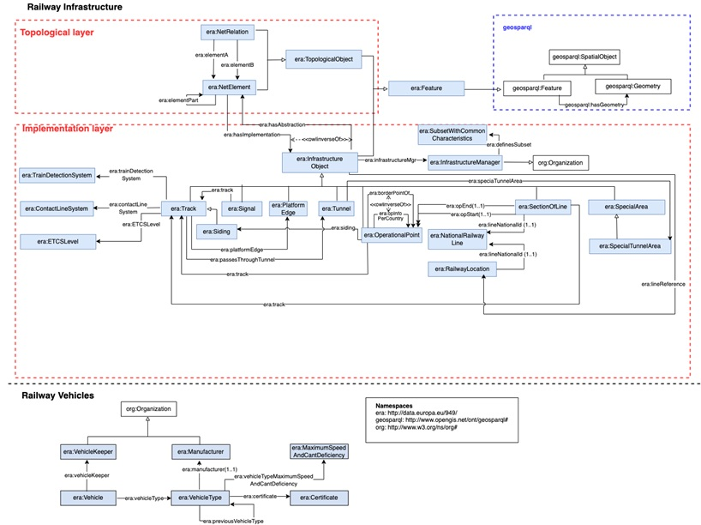
ERA Ontology Overview – v3.0.0
https://data-interop.era.europa.eu/era-vocabulary/

Slide 5
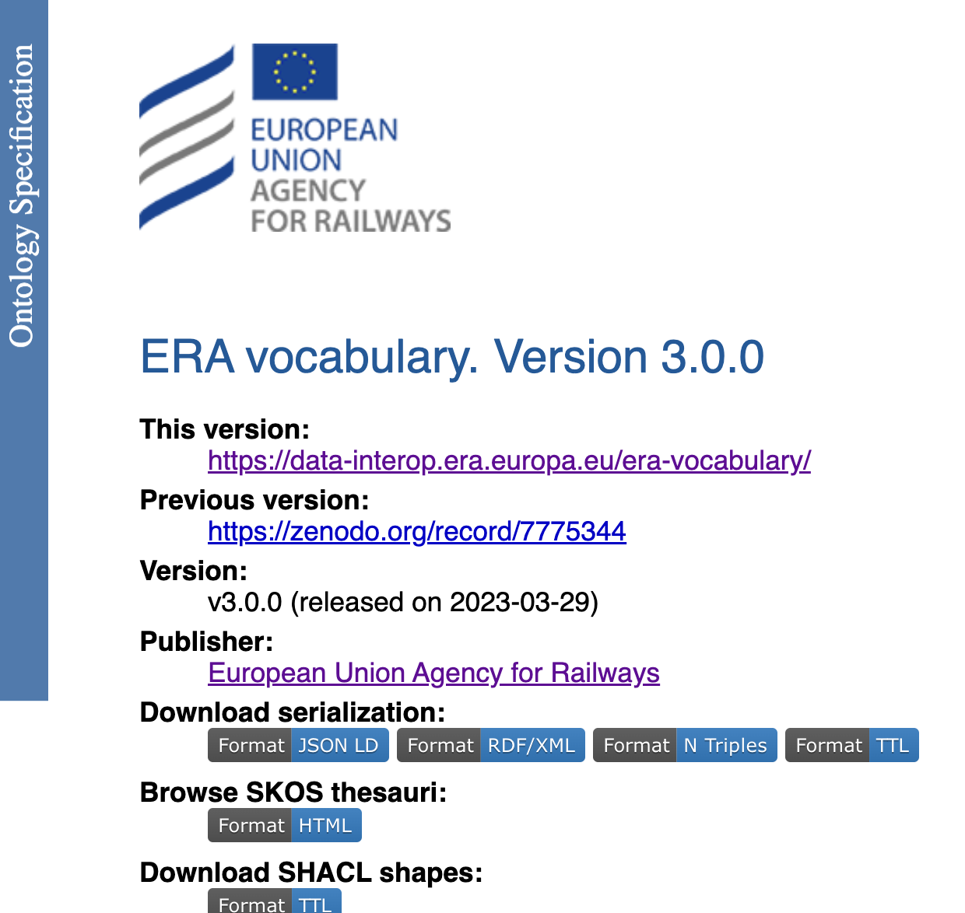
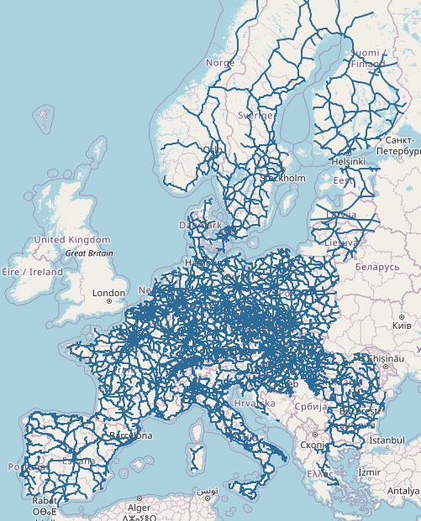
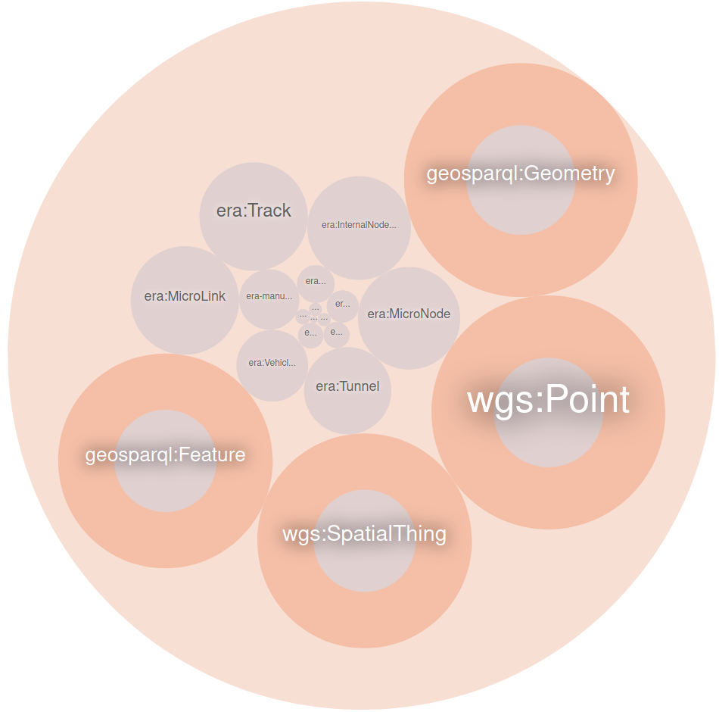
RINF — Map explorer. https://data-interop.era.europa.eu/
ERA KG endpoint
More than 47 million triples
More than 31k lines of mappings
More than 100 SHACL shapes
+270k track segments described
+50k stations described
+50k geo-referenced objects (lat/long)
+2k Vehicle Types described
27 countries covered (EU countries)
ERA — Route Compatibility Check (europa.eu)

Slide 6
Data modelling requirements
Different levels of granularity of data
Topological and topographical representation of railway infrastructure
Model the temporal constraints for the technical characteristics

Slide 7
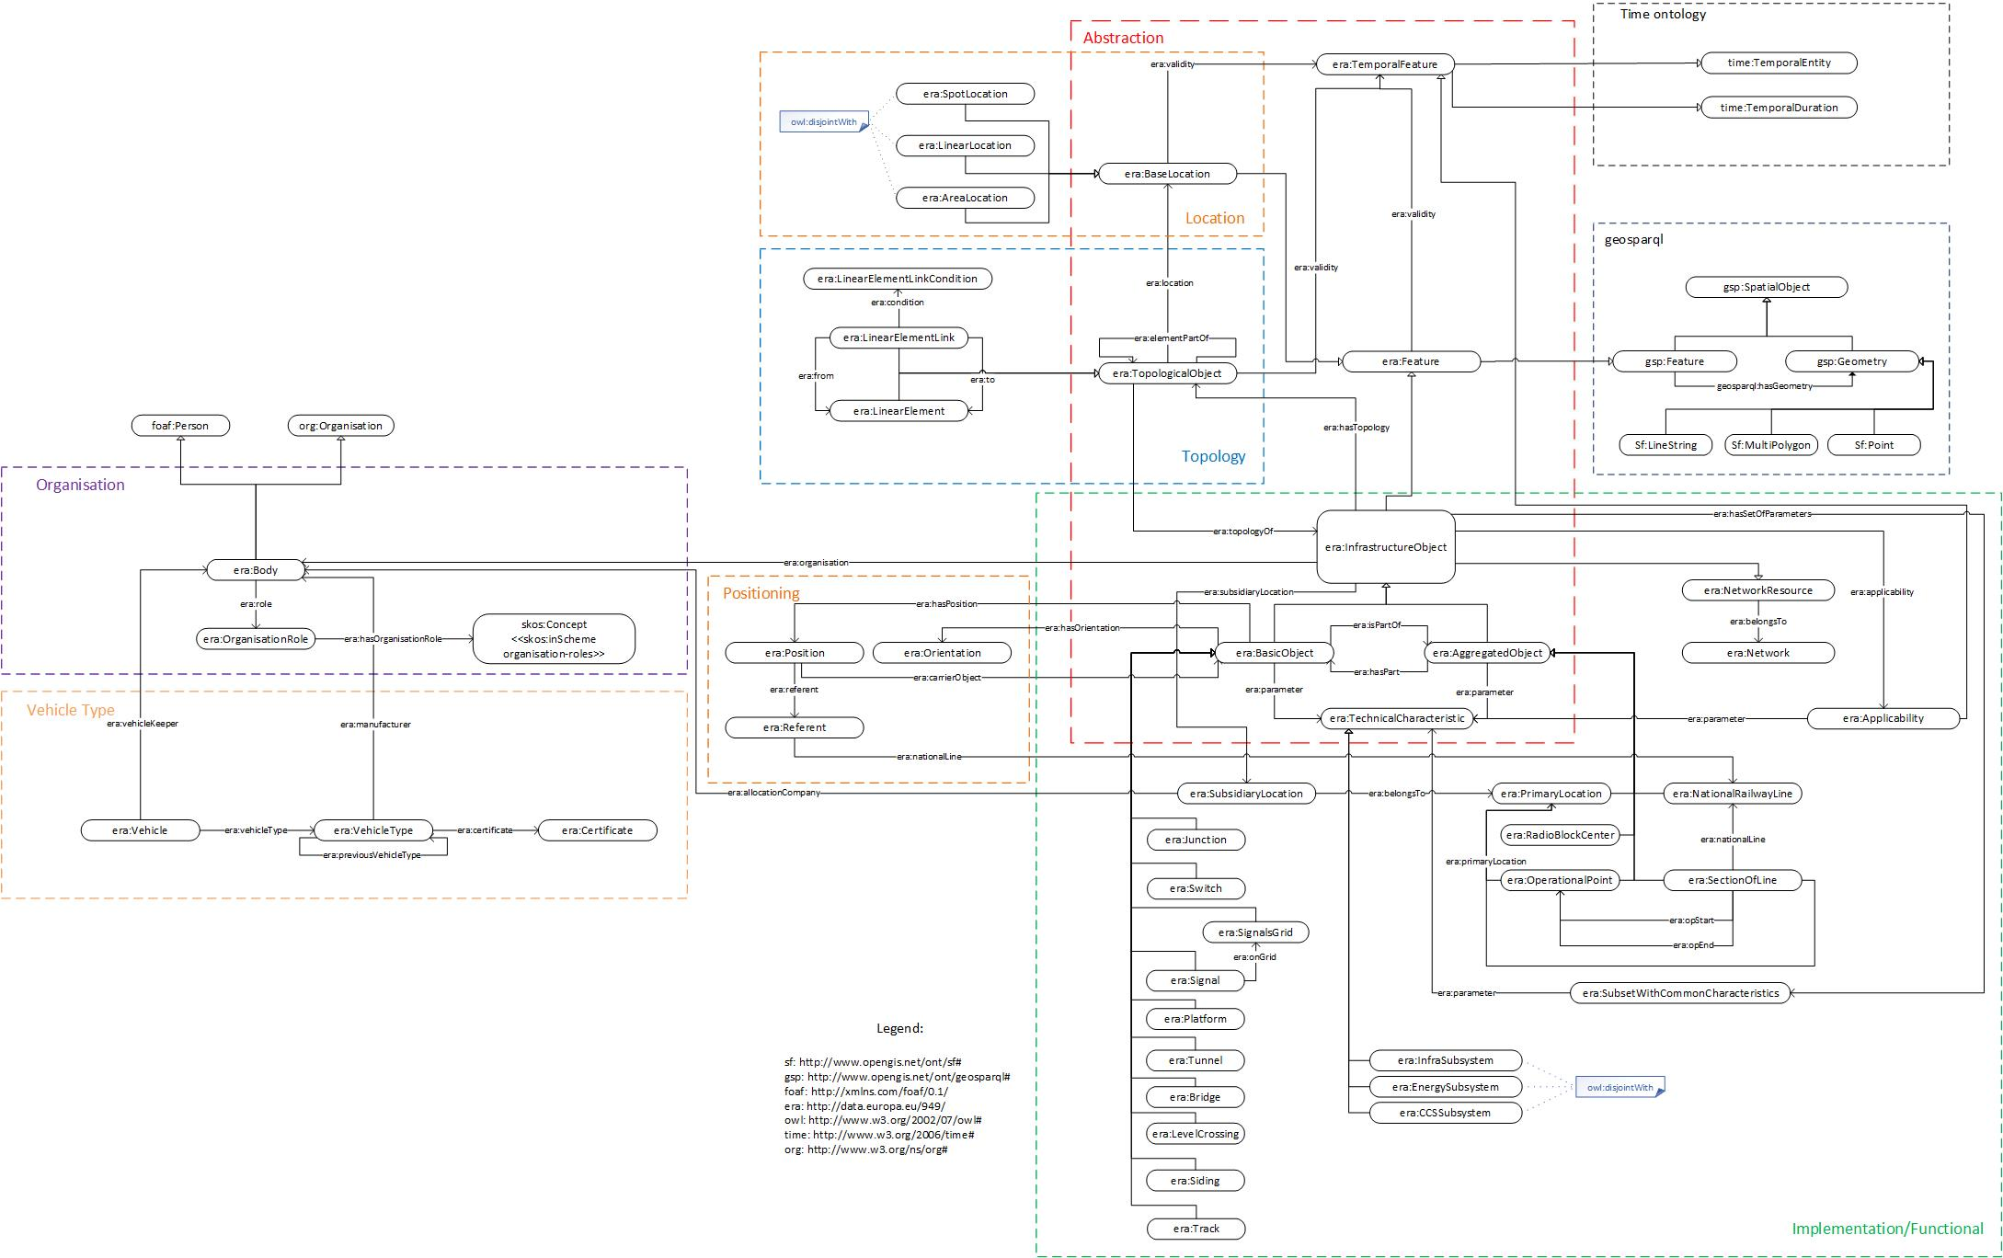
Integration of multi-levelled data model

Slide 8
Use cases covered
Route book data compilation
Tracks connectivity and navigability
Better geographical representation
Telematics locations data integration
Future planning for the infrastructure
Route compatibility check
Schematic representations
Extended version of the ERA Ontology (github.com) v. 3.1.0

Slide 9

The importance of moving towards semantic technologies
Regulatory compliance
Enhanced data interoperability
Scalability and flexibility
Cost efficiency
Increased predictability

Slide 10
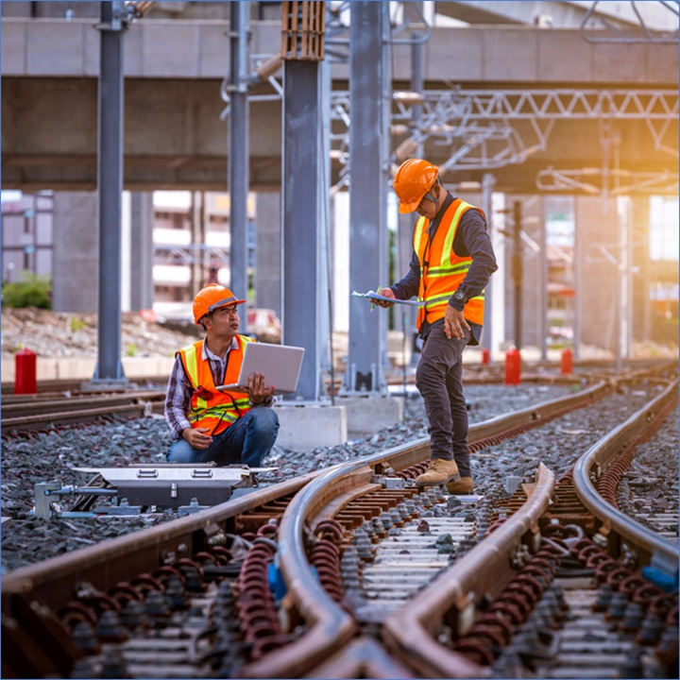
Competency questions
CQ 1
CQ 3
CQ 4
CQ 5
CQ 6
CQ 7
CQ 8
CQ 9
CQ 10
CQ 12
CQ 13
CQ 14
CQ 16
CQ 18
CQ 19
CQ 20
CQ 21
CQ 2
Which are the distinct values for a particular parameter P of a track in member state C?
How many tunnels are there per member state?
What is the tunnel length per member state?
What is the railway length per member state? (takes into account sections of lines and tunnels)
What are the platform lengths in ascending order? (What is the variety of platform lengths in Europe?
What are the parameters of a certain entity E in the vocabulary
Which are non TSI compliant legacy signaling systems existent in the different countries?
What are the number of tons per track?
Which are the energy supply system values (voltage frequency) per SOL per member state?
What is the network of an infrastructure manager IM?
Which are the diesel vehicle types?
Which are the tracks with a contact line system type that is not electrified
What is the track length of Trans-European Transport Network (TEN-T) lines per member state?
How many tracks are equipped with GSM-r per member state (rate of deployment)?
Which are the tunnels in Belgium that are not category (rolling stock fire category) A nor B?
How many countries are using local and non-international Gauges (gauging profile)?
What are the available values for the GSM-R version per member state?
What are the available ETCS levels per member state?
ERA Knowledge Graph | Data Stories

Slide 11
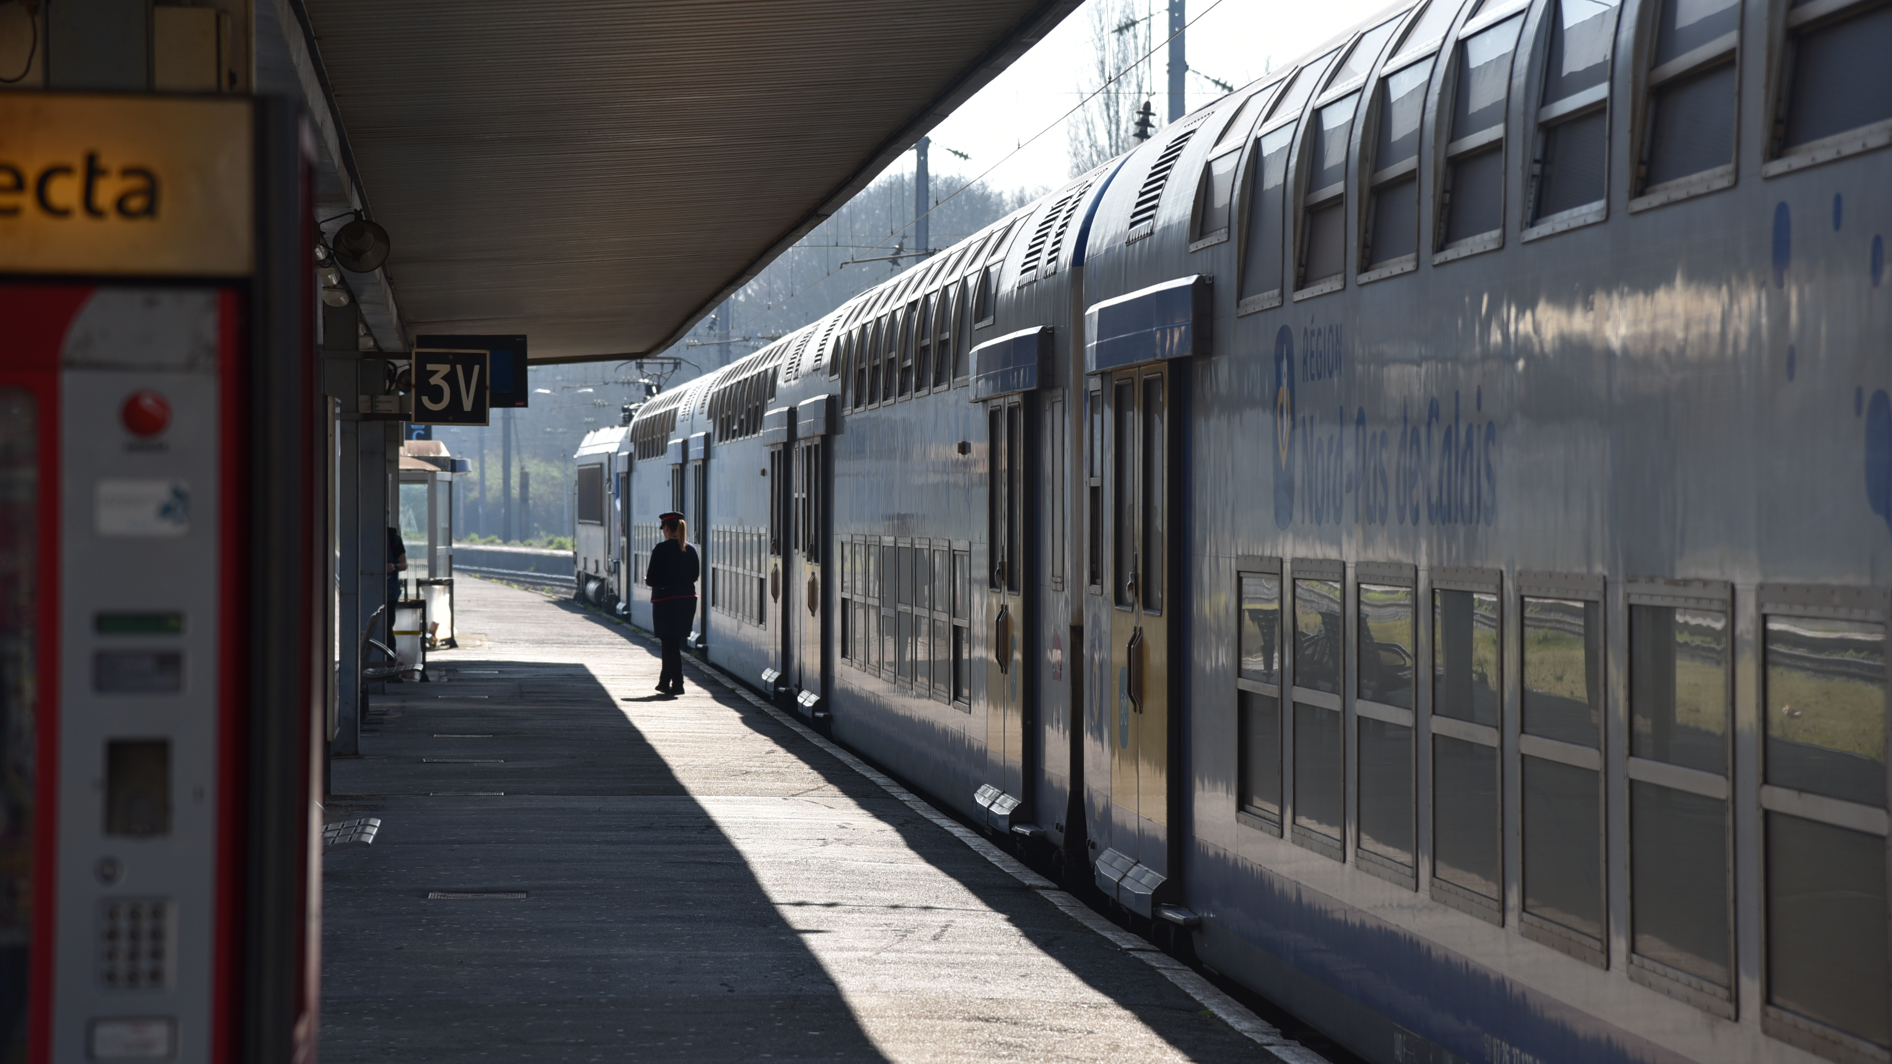
Benefits and Challenges

Slide 12

Benefits and challenges of an extended data model
Benefits:
Enhanced data representation for an improved decision making
Enhanced safety
Increased efficiency
Scalability and flexibility
Challenges:
Complexity of the model and the data integration
Data quality and consistency
Handling large volume of data

Slide 13
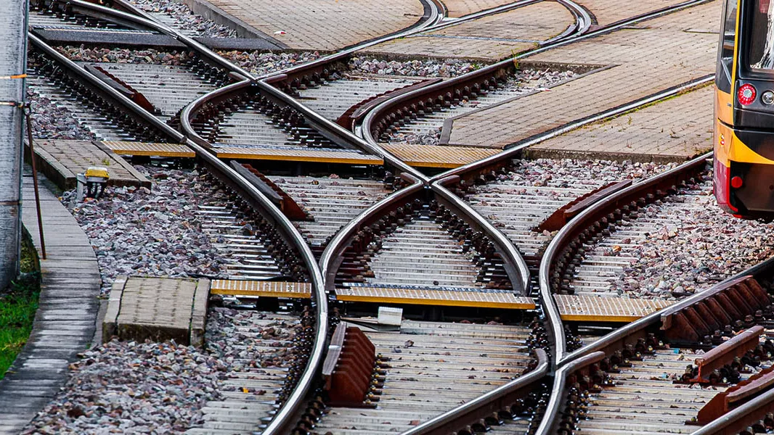
A little semantics goes a long way rail
Notes:
Jim Hendler

Slide 14

Take Away Message
Use of Open Software
Use of W3C and open standards
Aligned with other ontologies
Aligned with existing models (UMLs, XSD, etc.)
New questions to the knowledge graph formulated on demand
Data more relevant than the application layer Easily extendable with other sources
Railway infrastructure managers provide data in RDF for usage.
ERA publishes and maintains railway infrastructure using (open) semantic web technologies.
Public Endpoint: https://virtuoso.ecdp.tech.ec.europa.eu/sparql

Slide 15
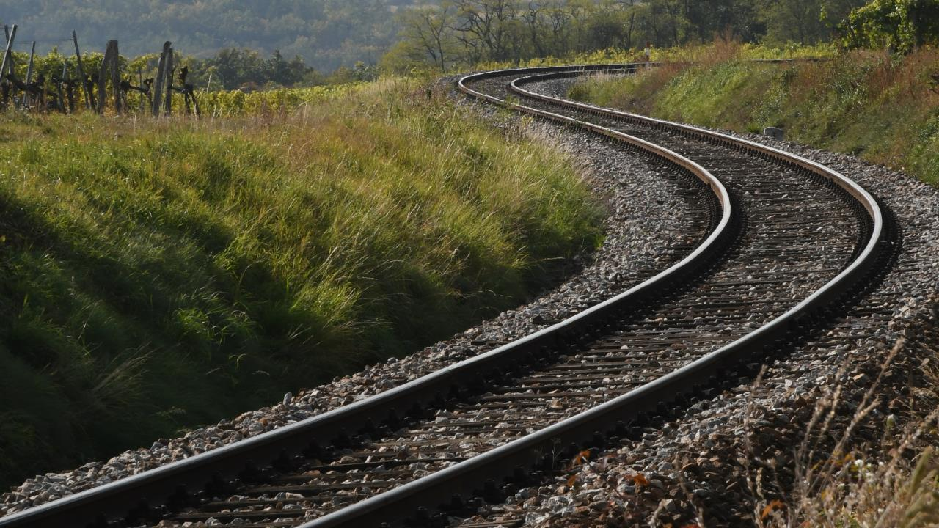
THANK YOU
Moving Europe towards a sustainable and safe railway system without frontiers.
Follow us:

