Slide 1


Ian Conlon
EU-RAIL Joint Undertaking
OPENING: KEYNOTE SPEECHES

Slide 2
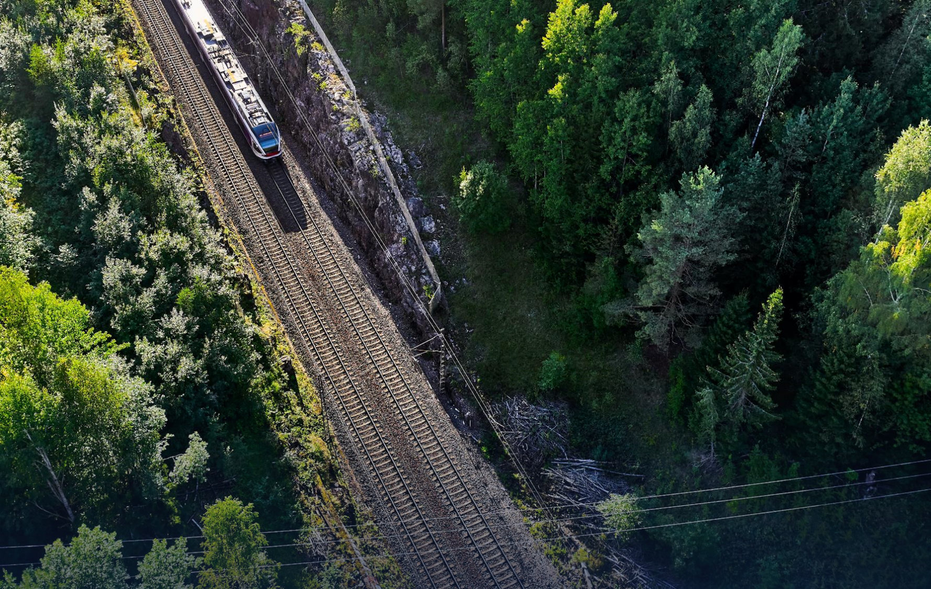
EU-Rail Joint Undertaking
IAN CONLON
Head of EU-RAIL System Pillar

Slide 3
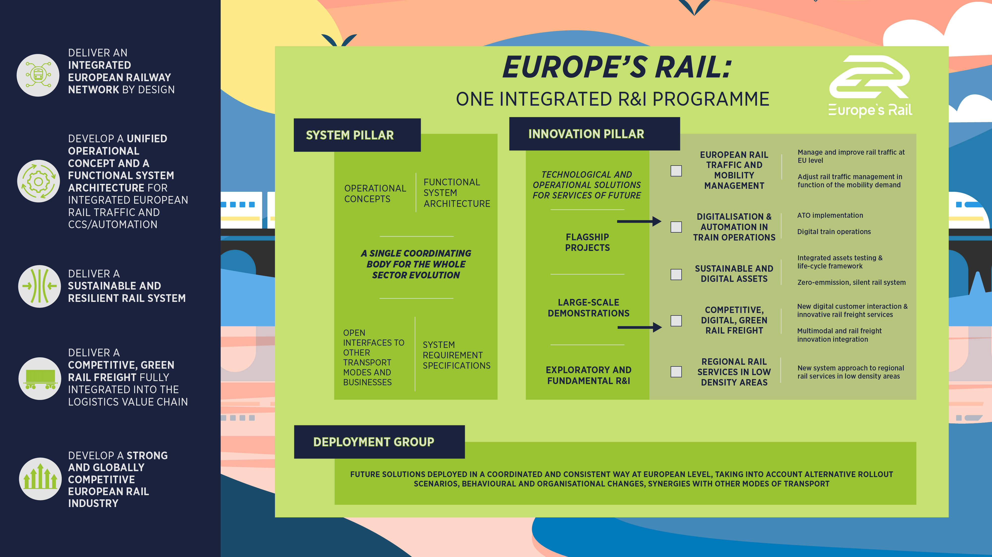
General Assembly
REPORT FROM SYSTEM PILLAR STEERING GROUP

Slide 4

EU-RAIL DIGITAL ENABLERS
Dramatically increased efficiency & reduced costs for the rail design, testing and certification processes
Facilitate the implementation of predictive maintenance
Reduced maintenance and operation costs for the rail system
Enable interoperability
Introduce a de-centralised, secure rail data marketplace
Rail services integration with multi-modal mobility
Enhances the competitiveness and sustainability of the rail sector
ERA-ontology → CCS/TMS data model
Digital Twin
Federated Rail Data Space
Conceptual Data Model (CDM) & semantic dictionary evolution
Significant value in a European approach
Notes:
The general objectives of EU-Rail are to:
contribute towards the achievement of the Single European Railway Area.
ensure a fast transition to more attractive, user-friendly, competitive, affordable, easy to maintain, efficient and sustainable European rail system, integrated into the wider mobility system.
support the development of a strong and globally competitive European rail industry.
The specific objectives of EU-Rail are to:
facilitate research and innovation activities to deliver an integrated European railway network by design, eliminating barriers to interoperability and providing solutions for full integration, covering traffic management, vehicles, infrastructure, and services, and providing the best answer to the needs of passengers and businesses while increasing capacity and reliability and decreasing costs of railway transport.
deliver a sustainable and resilient rail system by developing a zero-emission, silent rail system and climate resilient infrastructure, applying circular economy to the rail sector, piloting the use of innovative processes, technologies, designs and materials in the full life cycle of rail systems, and developing other innovative solutions to guided surface transport.
develop through its System Pillar a unified operational concept and a functional, safe, and secure system architecture, with due consideration of cyber-security aspects, for integrated European rail traffic management, command, control and signalling systems, including automated train operation, which shall ensure that research and innovation is targeted on commonly agreed and shared customer requirements and operational needs.
facilitate research and innovation activities related to rail freight and intermodal transport services to deliver a competitive green rail freight fully integrated into the logistic value chain, with automation and digitalisation of freight rail at the core.
develop demonstration projects in interested Member States.
contribute to the development of a strong and globally competitive European rail industry.
enable, promote, and exploit synergies with other Union policies, programmes, initiatives, instruments, or funds to maximise its impact and added value.

Slide 5
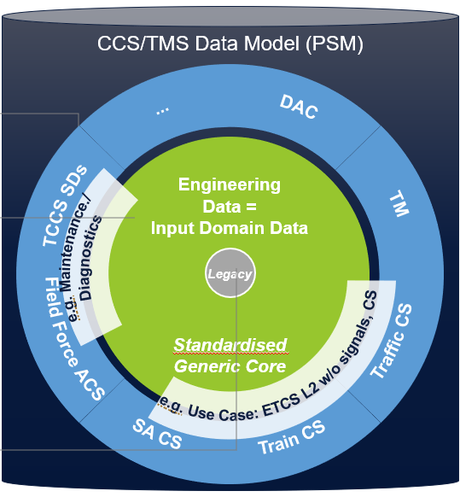

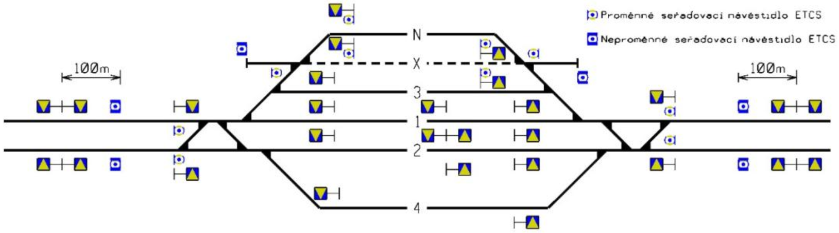
ERA-ontology enables the CCS/TMS data model; CCS/TMS data model enables EU-RAIL use cases
Data configuration & interface specifications (incl. diagnostic data) for the target ETCS-only CCS/TMS system (EU-RAIL System Pillar) speak „one common language“, derived from ERA ontology.
„Does the data comply with the CCS/TMS Data Model?“
ERA
Ontology
Geolocalised data
Correct and up-to-date from track geometry data provider
OR
New measurement that shall have at least 10 cm and should have 1 cm tolerance.
„Is the balise at least in 5,0 m distance from the fouling point?“
CCS/ TMS data model
Validation
Tool*
raw data
config data
Tool supported asset engineering
CCS planning rules
Notes:
Inspired from the HF case from Eurocontrol, already well implemented in the aviation sector., this methodology has been customised to better meet the needs of the railway sector and be consistent with the railway regulatory framework when a need for change is identified.
This methodology can be used for any change: from a small change to a more complex change involving many subsystem changes (ie organisational change, IT change…). A thorough description of the desired change is needed, as it may be necessary to break it down and study the interactions in several separate parts, that may not have been identified at first, this includes different systems, subsystems, teams, activities...
This methodology is composed of five steps, as can be shown in figure
This methodology should be applied from the start of a change i.e. when the need for change is identified. End-users should be involved from the very beginning, with the aim of identifying the specific HOF topics that will be included in the risk management process (and independent assessment, when needed, following requirements of Regulation EU 402/2013).
To increase efficiency, this methodology can be carried out in parallel or using the same resources (e.g. existing documentation, meetings/workshops…).
The methodology should be guided or used by a HOF specialist, and if not available by someone with HOF expertise. People using this methodology should be specifically trained to use it. Several roles mentioned can be fulfilled by the same individual, especially for smaller companies and/or smaller changes.
In conformity with chapter 1.6, this methodology should ensure that HOF is integrated in change management in a balanced manner to avoid pressure or influence, as far as possible. The first question in determining whether to apply this methodology is: could this change have any impact (direct/indirect) on staff carrying out safety-related tasks?

Slide 6

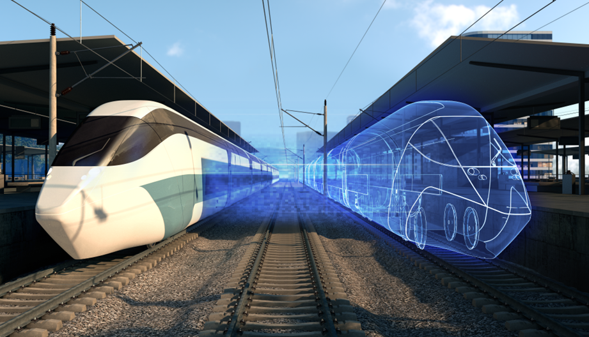
Digital Twin (DT)
OBJECTIVE: DT enabler aims to organise and support the assembly, verification, validation, testing & co-simulation of complex high-order Digital Twins that are capable of digitally representing the behaviour of the physical railway system.
Benefits
Increases Assets utilization and Sustainability
Enables exchange of digital artefacts of railway assets
Reduces operational cost through predictive maintenance
New opportunities with AI

Slide 7
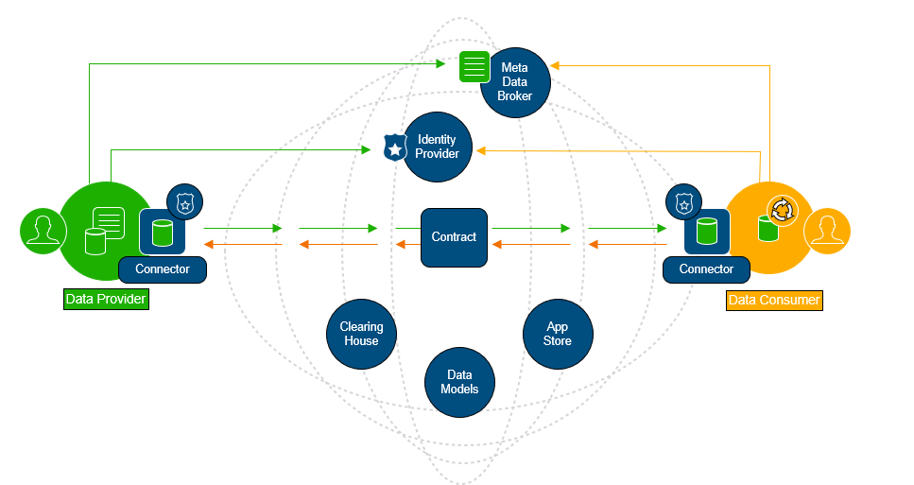

Federated Data Spaces
OBJECTIVE: The focus of the Rail Data Space (RDS) is on creating a decentral, secure and open data ecosystem to drive rail innovations with a provider-oriented governance.
Benefits
Revolutionise the rail sector with a de-centralised, secure, and open rail data marketplace
Ensure compatibility and interoperability with other data spaces to lay the foundation for rail inno-vations in a comprehensive mobility system
Enhancement of competitiveness and sustainability for the rail industry​
Rail Data Space
Benefits

Slide 8
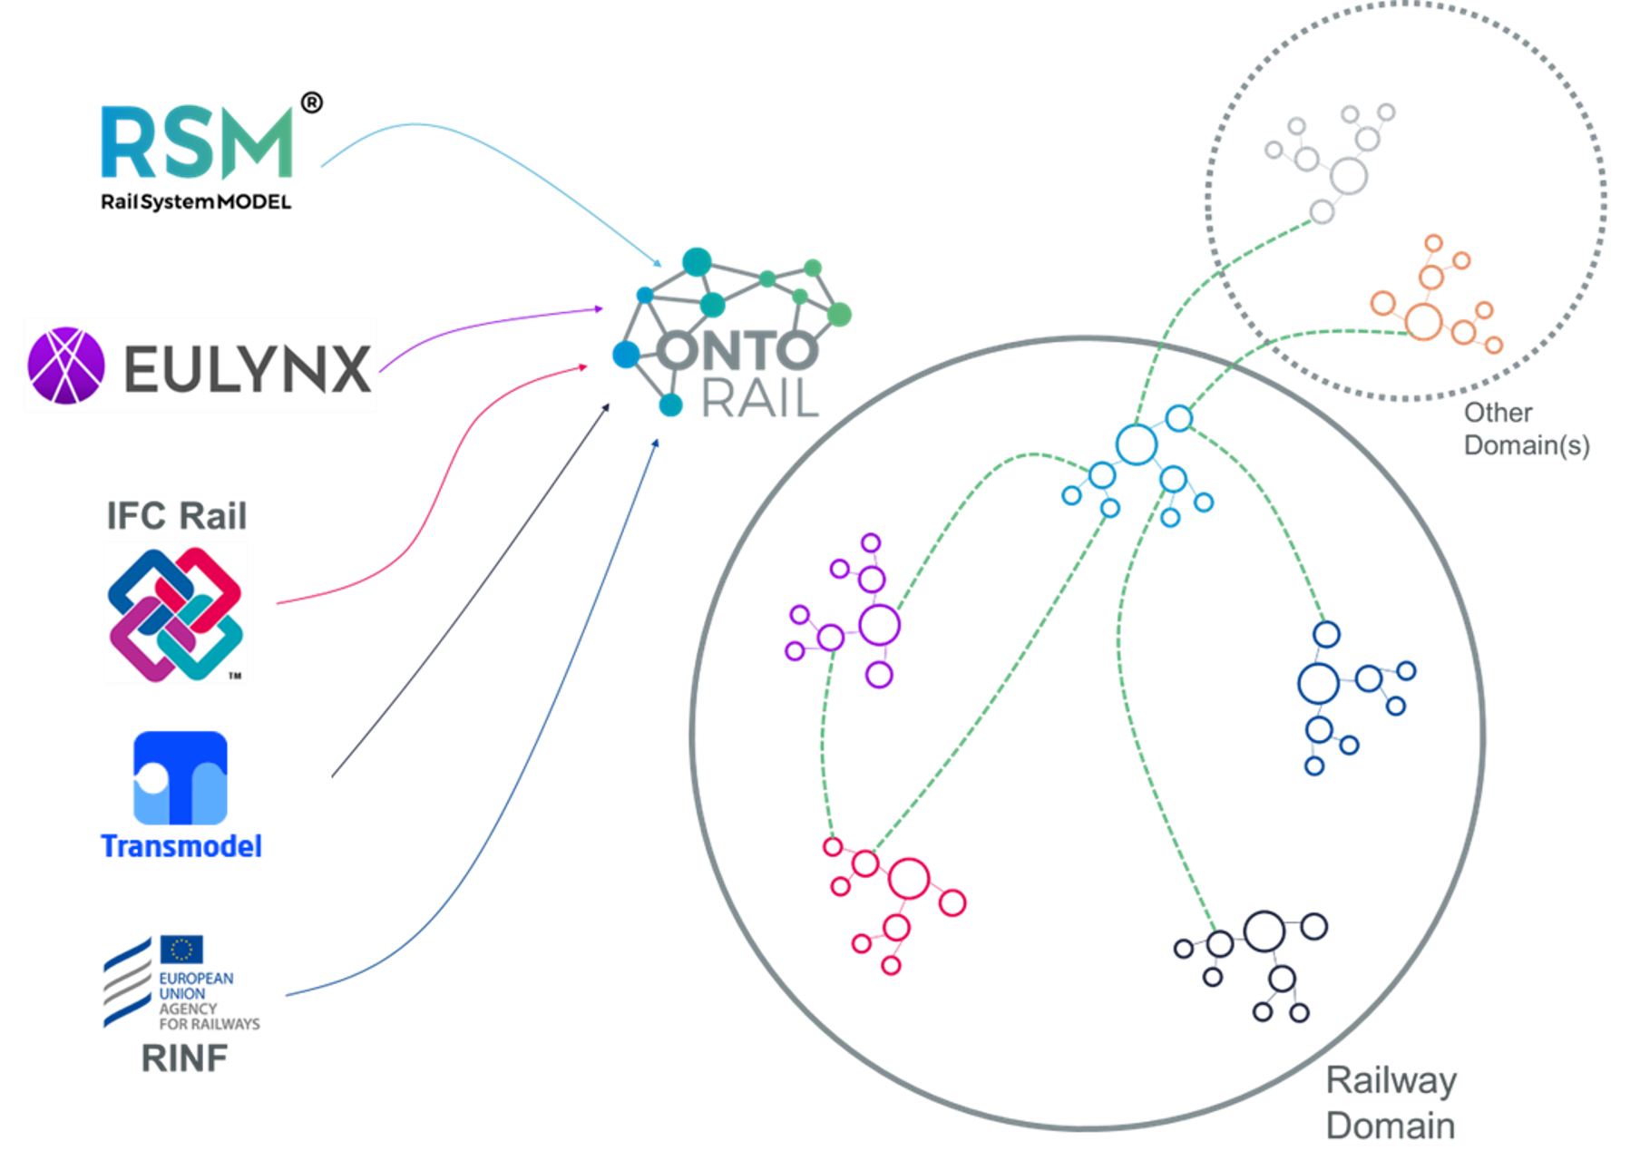
Conceptual Data Model & Semantic dictionary evolution
OBJECTIVE: The Conceptual Data Model aims at creating a common standardised ontology based machine-readable model of the rail system domain, formally describing syntactic and semantic data structures.
Benefits
Fosters reuse and maintainability of the information systems
Source of Knowledge for domain users
Enables interoperability by federating and linking source models
Follows and supports the ERA vocabulary
Complementary to the SP TMS/CCS data model
Benefits
ERA Ontology

Slide 9
Thank you

