Slide 1
Josef Doppelbauer
European Union Agency for Railways
OPENING: KEYNOTE SPEECHES

Slide 2
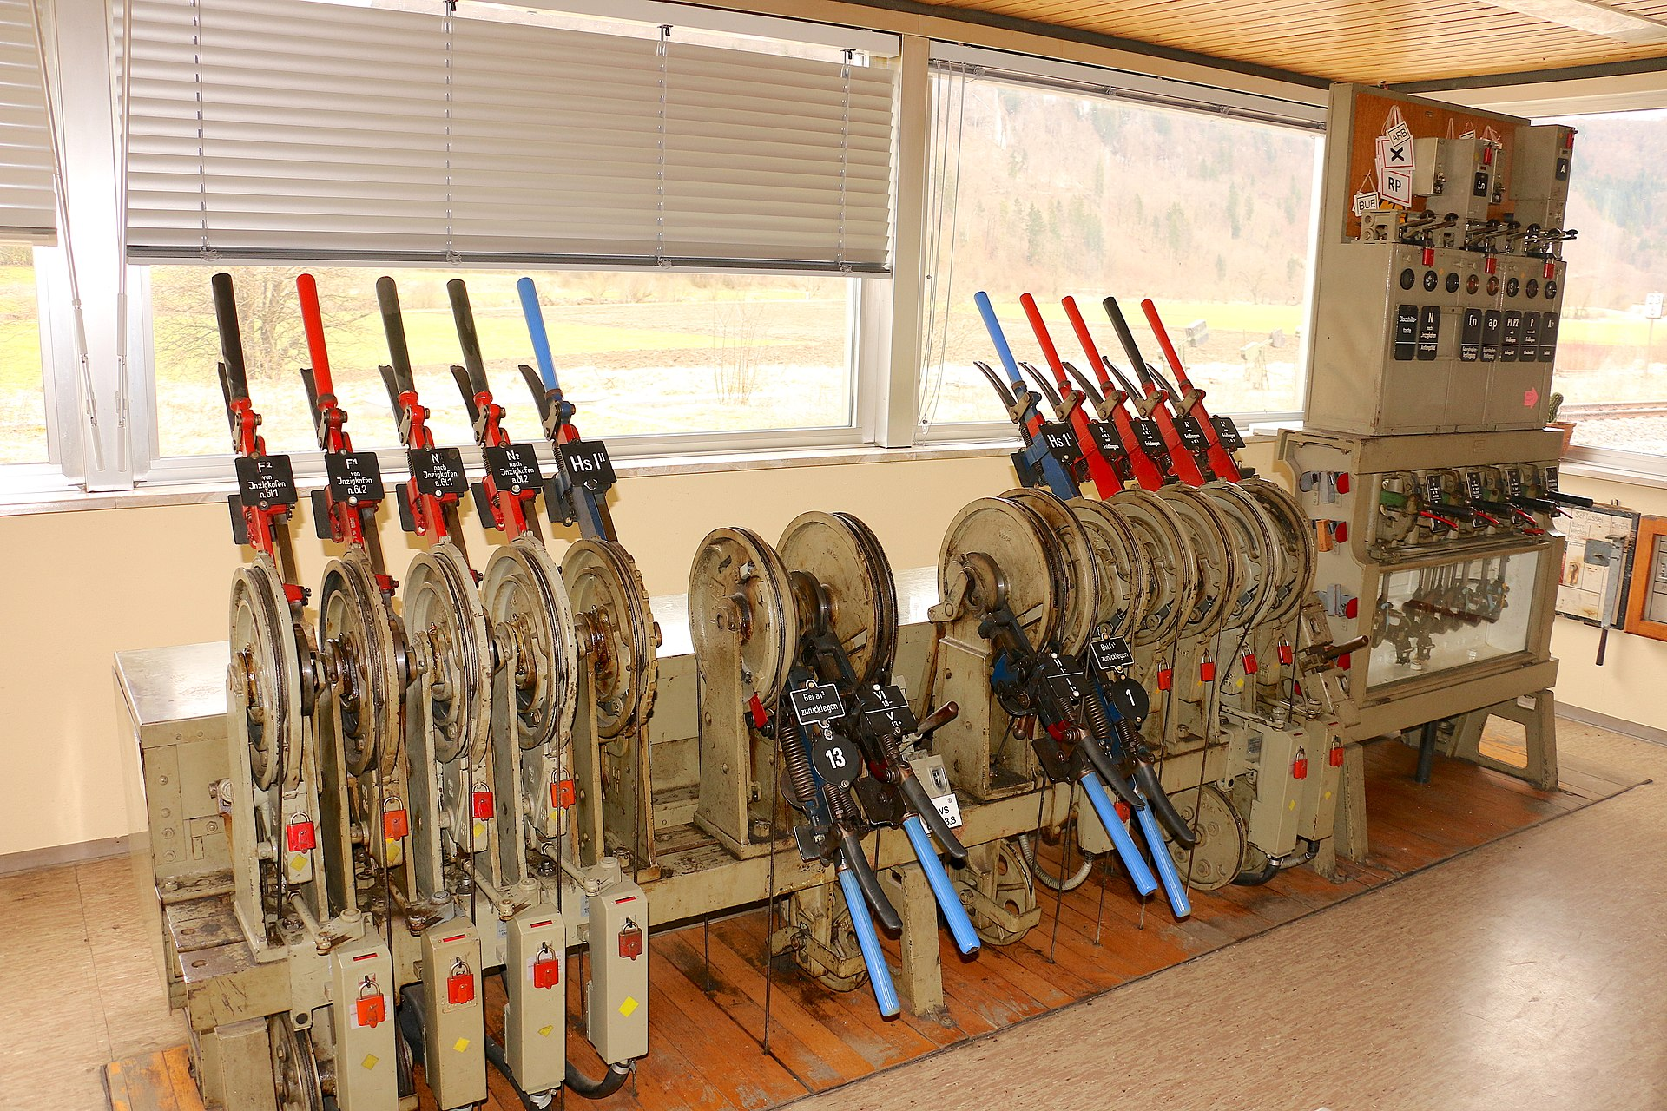
Transformation of the Railway System
Digital technology can be disruptive in all aspects of the transport chain, also helping to integrate transport modes (seamless multi-modal transport)
From analog to digital systems - physical vs. digital infrastructure; generalization of electronic components and information and communication technologies, drastically increased connectivity
From manual operation to automation
From proprietary HW to COTS; SW: move to open SW (IOT devices?); appearance of cloud-based systems
National systems vs. European integration (cross-border risks)
Modal siloes vs. multimodality – intercommunication of threats
Application of Artificial Intelligence (AI) techniques
Notes:
Evolution of the Railway System – greater operational efficiency (automation), improved diagnostic options from digital transformation -changed exposure to Cyber risks
Types of threats:
Criminal attacks
Strategic attacks – sabotage (offensive or defensive players)
The threat landscape for rail is evolving, in particular because of the increasing degree of connectivity, both in the infrastructure and of rolling stock.
The (complex) system beats itself
Monday, 29.04.2024 GPS Spoofing Baltic Sea (Estonia) – suspected origin. Russia

Slide 3
The Digital Railway System
“Users”
Data layer
Accessibility/Efficiency/Economy/Multimodal Integration
(quasi)static data
dynamic data (sensors)
“data do not know borders”
Enablers: e.g. DAC
Services layer
Services possible across (IM) borders
RU 1
RU x
RU 2
Infrastructure layer
Timetable is the interface between Infrastructure and Service layers
“Product” of IMs: train paths
IM 1
IM 2
IMs
Core purpose: as part of the integrated transport system enable transport of people and goods
Notes:
Data can be used for different purposes:
Information about delays, construction sites, train paths, predictive maintenance, …
Compare digitalization to electrification:
Higher power – longer and heavier trains
Higher speed
Faster acceleration
One-man operation
Range
Availability
Reliable timetable is basis for quality
Sensors (e.g. fibre acoustic sensing) data -> machine learning -> AI
Safety
Environment – land slides

Slide 4
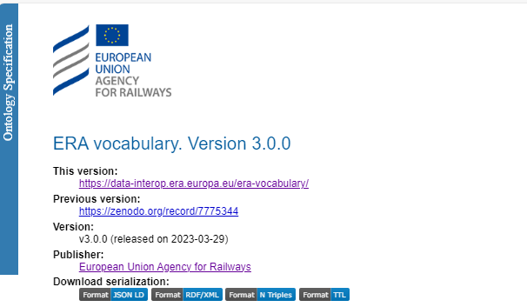
ERA Ontology
Advantages Allows the description of the data in a precise and unambiguous way
Describes the data in a homogenous way
The information will improve its quality over time
Datasets can be more easily linked to each
Based on open W3C standards
Semantic (SPARQL) queries can be made
Findability/ Reusability
Expandable
Rail interoperability – EU harmonised specifications for trains, rail infrastructure, and passenger accessibility (MegaPack: TSI INF, ENE, PRM, WAG, LOC&PAS, NOI, RINF Regulation)
Entry into force 28 September 2023
..”It is not because things are difficult that we do not dare, it is because we do not dare that they are difficult.” (Lucius Annaeus Seneca)
Notes:
In 2018, the Agency initiated a journey towards a data centric organization in a data rich world.
Building interfaces between application
Data warehouse and data lakes
Sharing data with APIs
Agency Role Hosting Registers, Reports, Safety Performance indicators …no extracting Knowledge
Identifying key datasets
Facilitating Data Exchange of those key datasets
Monitoring Data Exchange of those key datasets
MB Decision n° 250 (https://www.era.europa.eu/agency/management-board/management-board-decisions_en)
The vocabulary allows the representation of all the concepts and relationships that are part of the railway infrastructure and the vehicles that operate over it. Two of its main advantages are 1. and 2., 3. derives from them and 5. allows to query datasets that have been described with the vocabulary
Now, instead of having a pdf that is the application guide that is only understandable by humans, we have a vocabulary that is understandable by humans and machines. Having a vocabulary is also important for reusability purposes, now from any application, the terms of the vocabulary can be reused in the same way that we reuse terms from other vocabularies or ontologies such as the geographical ones or the ones of the publication office.

Slide 5
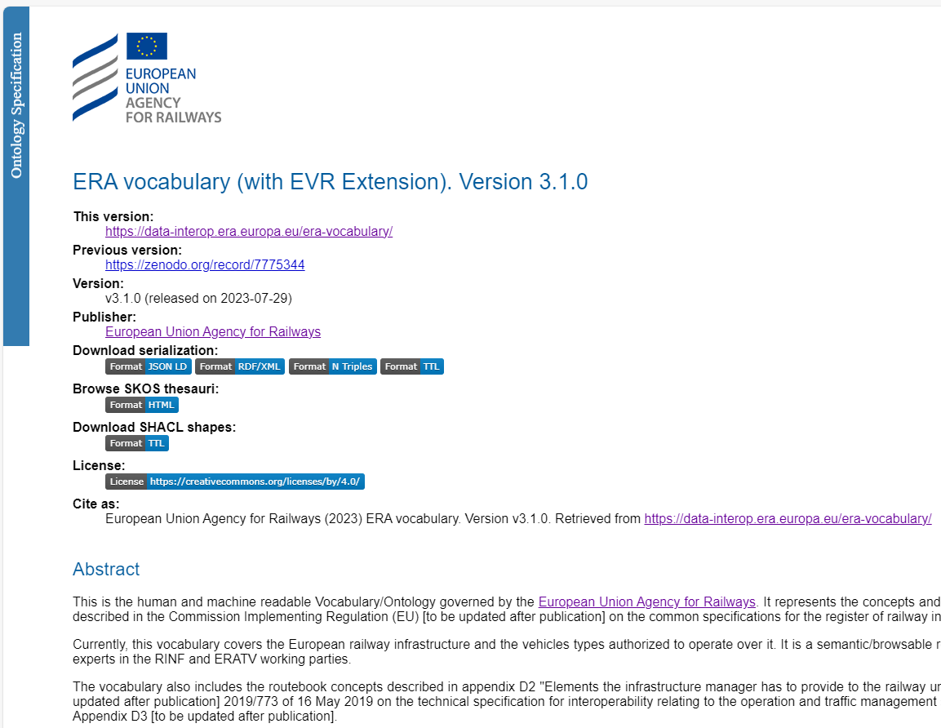
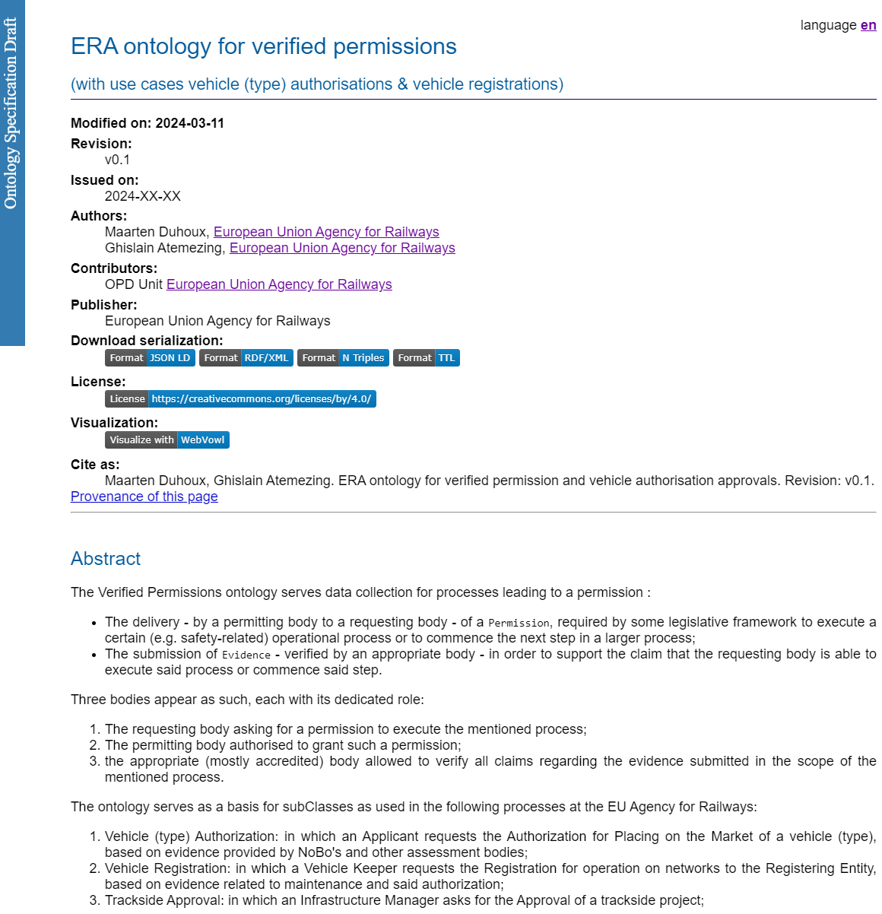
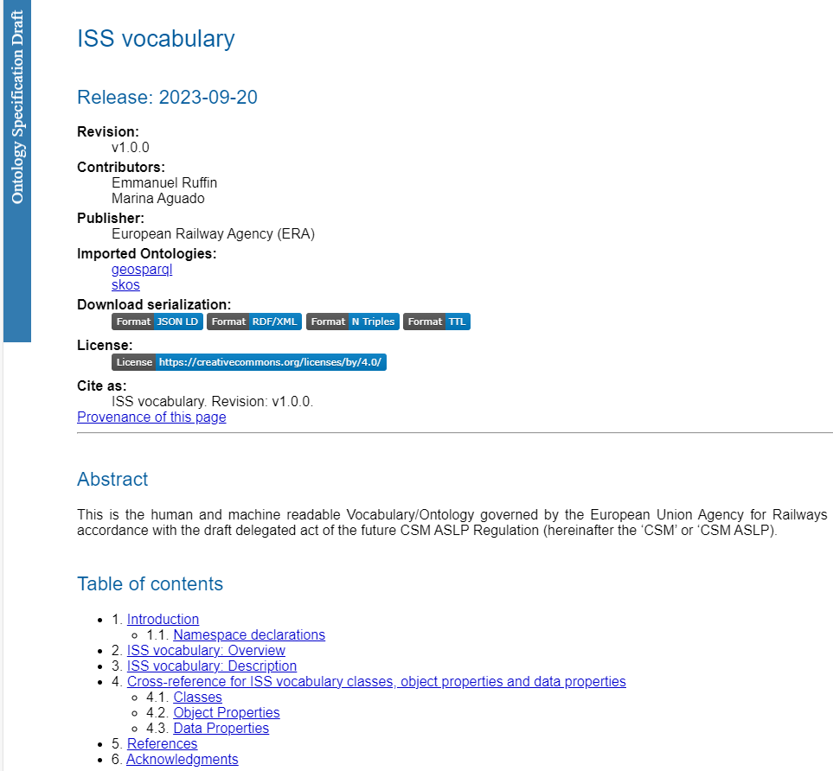
Ontology Extensions – new technology allows faster development
Notes:
Semantic technologies allow a more responsive system, able to adapt more quickly to emerging needs, reusing data between systems without the need for application interfaces.

Slide 6
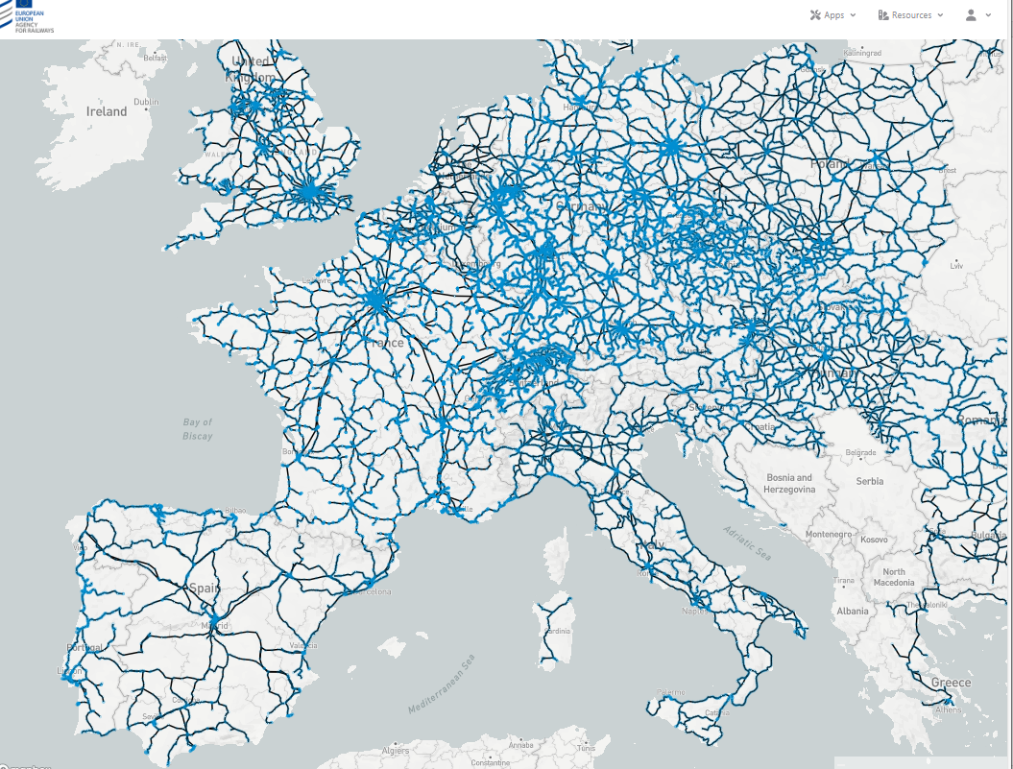
The New RINF (since 2022)
https://data-interop.era.europa.eu/
More than 30 million data statements (aka triples)​
+ 270k Track segments described​
+ 50k stations (aka Operational Points) described​
+ 50k geo-referenced objects (lat/lon)​
+ 2k Vehicle Types described​
27 countries covered​
Notes:
All clickable.. All linked to publication office…

Slide 7
Telematics TSI Revision – Common Standards for Rail and Multimodal
TAP TSI (EU) 454/2011
Goal: Integration of rail in multimodal passenger information and ticketing by using common standards
European Standard “Public Transport Reference Data Model” (EN 12896)
Basis for defining exchange standards that enable the sharing and provision of accurate and interoperable public transport information across organisation- and system-boundaries (CEN/TS 16614-* (NeTEx)
Provides a consistent language that covers many aspects of public transport.
Developed and enhanced over several decades by experts from many different countries in Europe
Developed within the European standardisation organisation CEN
Ticketing
Reservation interfaces
Real-time data
Timetable data
Tariff data
MMTIS (EU) 2017/1926
Notes:
Since a number of years, ERA has in its strategic calendar a workstream on digital and data
In order to boost digitalisation of rail freight, passenger information and ticketing, all related actors in the European Union need good quality data, that is Findable, Accessible, Interoperable and Reusable.
Without such good quality reference data there is no possibility to efficiently exchange data between the actors.

Slide 8
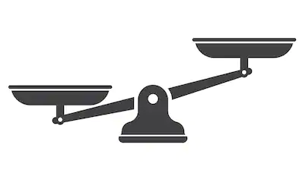
Cybersecurity - the Need to Balance
Be aware of the risks
Cyber risks vs. railway risks
Rapid measures vs. non-regression analysis
Operational requirements, business competitiveness
Potentially fatal or incredibly costly consequences
Notes:
Cybersecurity for rail IT and OT must be proactive and continuous
Increase awarenenss, foster collaboration, adopt to evolving regulatory environments
Protective security measures Defensive security measures Resilience measures
Assign subsystems to smaller, specialized manufacturers
Network segmentation - balancing connectivity with cybersecurity – harnessing the benefits while mitigating the risks of interconnected systems.
Continuous monitoring and detection of vulnerabilities and misconfigurations
Static and dynamic security requirements
Need a Cyber Security Management System
Validation of Cyber security Measures – are we sure we have done it right?
Are we resilient enough – weakest link
Similarities with Safety
Sovereign actors; Hacktivists
Ports – importation of organized crime

