Slide 1
Data quality process at Ferrovie dello Stato Italiane
Official Statistics and data dissemination
19 June 2024

Slide 2
01
The FS Group
3
02
Data provision
7
03
Data dissemination
14

Slide 3
The FS Group
a leader mobility company

Slide 4
FS Group Key numbers
19/06/2024
Data quality process at Ferrovie dello Stato Italiane | Lorenzo Vannacci
16,800 km of railway lines
1,670 tunnels
23,000 bridges and viaducts
2,200 railway stations
32,000 km of roads
2,000 tunnels
18,000 bridges and viaducts
1,200 roadman’s hoses
10,000 trains/day
7 millon vehicles/day on the roads
Turkey
Canada
Serbia
Uzbekistan
Holland
Germany
India
*
USA
United Kingdom
Romania
Colombia
Algeria
Saudi Arabia
Spain
Australia
Greece
France
Egypt
More than 82,000 people
Ethiopia
Notes:
Give a minute to explain to who is not familiar who we are and what we are doing

Slide 5
The Strategy and the four business Hubs
19/06/2024
Data quality process at Ferrovie dello Stato Italiane | Lorenzo Vannacci

Slide 6
FS Research Centre
19/06/2024
Data quality process at Ferrovie dello Stato Italiane | Lorenzo Vannacci
Corporate Affairs
“ the in-house research service of the FS Group”
RESEARCH AND SCIENCE ADVISOR
Transport studies, demand analysis and academic coordination.
SCIENTIFIC CONTENT MANAGMENT
Dissemination and social publishing
MOST SHAREHOLDING
Partecipating to The National Centres on Sustainable mobility
OFFICIAL STATISTICS BUREAU Internal KPIs monitoring and official data provision
DECISION SUPPORT MODEL
Design and model development
STRATEGIC OBSERVATORY
Monitoring external KPIs and markets
https://www.fsitaliane.it/content/fsitaliane/en/fs-research-centre.html

Slide 7
Data provision
Official and certified data and quality control

Slide 8
Ratio
19/06/2024
Data quality process at Ferrovie dello Stato Italiane | Lorenzo Vannacci
Ferrovie dello Stato Italiane S.p.A. collects and manages the official data of the FS Group for the following purposes:
the completion of official statistical surveys and affiliation provisions
the development of strategic studies and monitoring
the definition of the Group's industrial policies and strategies
Management and coordination activities of Group companies

Slide 9
The Group Disposal n. 283/AD/2019 defines:
19/06/2024
Data quality process at Ferrovie dello Stato Italiane | Lorenzo Vannacci
The Group supervisor of the process of requesting, collecting and managing official data is FS Research Centre (/Official Statistics Bureau)
The process of transmitting the official and certified data from the FS Group Companies to the Holding Company Ferrovie dello Stato Italiane SpA and guarantee any other data communication.
The management of such data in the order to provide communication to national and international institutions, entities and associations for legal and other members’ obligations.
Identify the roles.

Slide 10
The FS Group Companies
19/06/2024
Data quality process at Ferrovie dello Stato Italiane | Lorenzo Vannacci
… are required to incorporate the contents of this Group Disposal into their internal regulatory system and guarantee the correct and constant application also at its Subsidiaries.
… also guarantee the correct and timely activation (or modification) and transmission to FSR of the official data flows requested.
… ensure the unique identification and the appointments of the requested roles, that can coexist in the same person or be exercised by distinct individuals.

Slide 11
Roles involved
19/06/2024
Data quality process at Ferrovie dello Stato Italiane | Lorenzo Vannacci
FS Holding
Official Statistic Bureau
Process Owner
Hub
INFRASTRUCTURE
LOGISTIC
PASSENGERS
URBAN
Company 1
Company n
ODR Official Data
Representative
DataFlow n
DataFlow 1
DataFlow 1
DC Data
Controller
RTD Data
Transmission
Manager

Slide 12
Official and certified data storage and external provision
Company #1
<< feedback to Company
FS Research Centre
ETL +
hashing
Quality check
Storage
Shared input folder
Ministry of Transport
National Institute of Statistics
UIC
…..
Automatic control
Staging monitor
Historical check (temporal stability)

Slide 13
Confidentiality, autonomy and independence
19/06/2024
Data quality process at Ferrovie dello Stato Italiane | Lorenzo Vannacci
All data is processed in compliance with the confidentiality obligations and the prerogatives of autonomy and independence of each Company and, in particular, of the Railway Infrastructure Manager.
… in compliance with the current provisions on competition, data protection on the management and disclosure of privileged information (also called "price sensitive") as well as with the current provisions regarding the classification of information in terms of confidentiality.

Slide 14
Data dissemination
Accuracy and opportunities

Slide 15
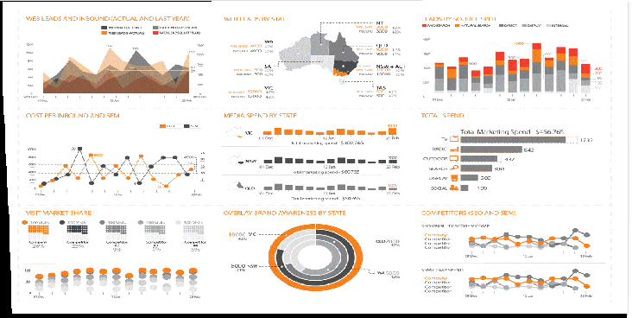
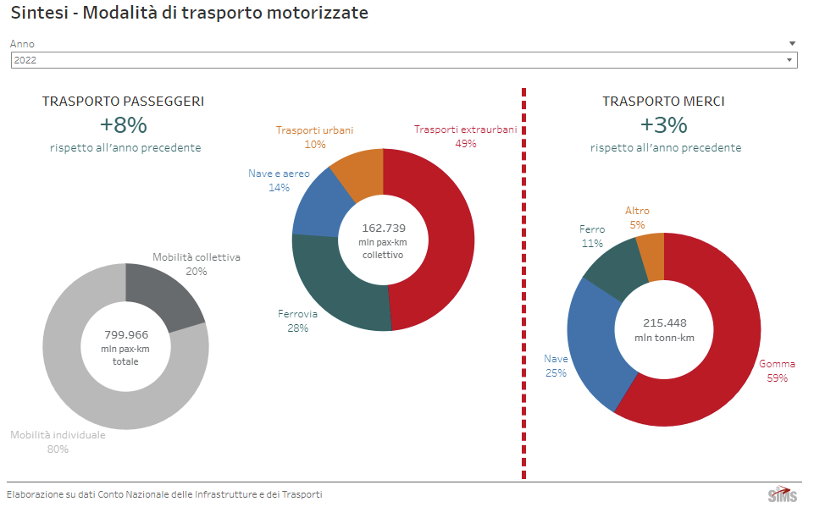
Data accuracy and dissemination
19/06/2024
Data quality process at Ferrovie dello Stato Italiane | Lorenzo Vannacci
FS Research Centre publishes monthly mobility data for Italy and Station attendance of Italian main stations Mobility based on mobile network data.
FS Research Centre collaborate with Italian Transport Ministry for mobility trends analysis.
There is a need of a previous data quality check before disseminating mobility data knowledge
How we can guarantee data accuracy of mobility analysis if we are not the data producer?
Data producer
FS Research Centre
Official statistics

