Slide 1
Harald Reisinger RailNetEurope
European Union Agency for Railways

Slide 2
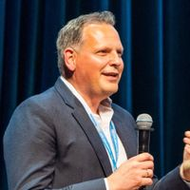
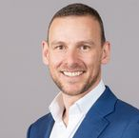
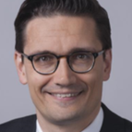
Harald Reisinger
RNE
Mathias Vanden Auweele
Julián Rojas
Infrabel
IMEC
Miguel Figueres-Esteban
Ingo Ritter
RENFE
Deutsche Bahn AG
Gilles Peterhans
Roland Klüber
UIP
Consilis GmbH
SESSION 4 – DATA PROVIDERS AND DATA CONSUMERS

Slide 3
Data providers and Data consumers

Slide 4
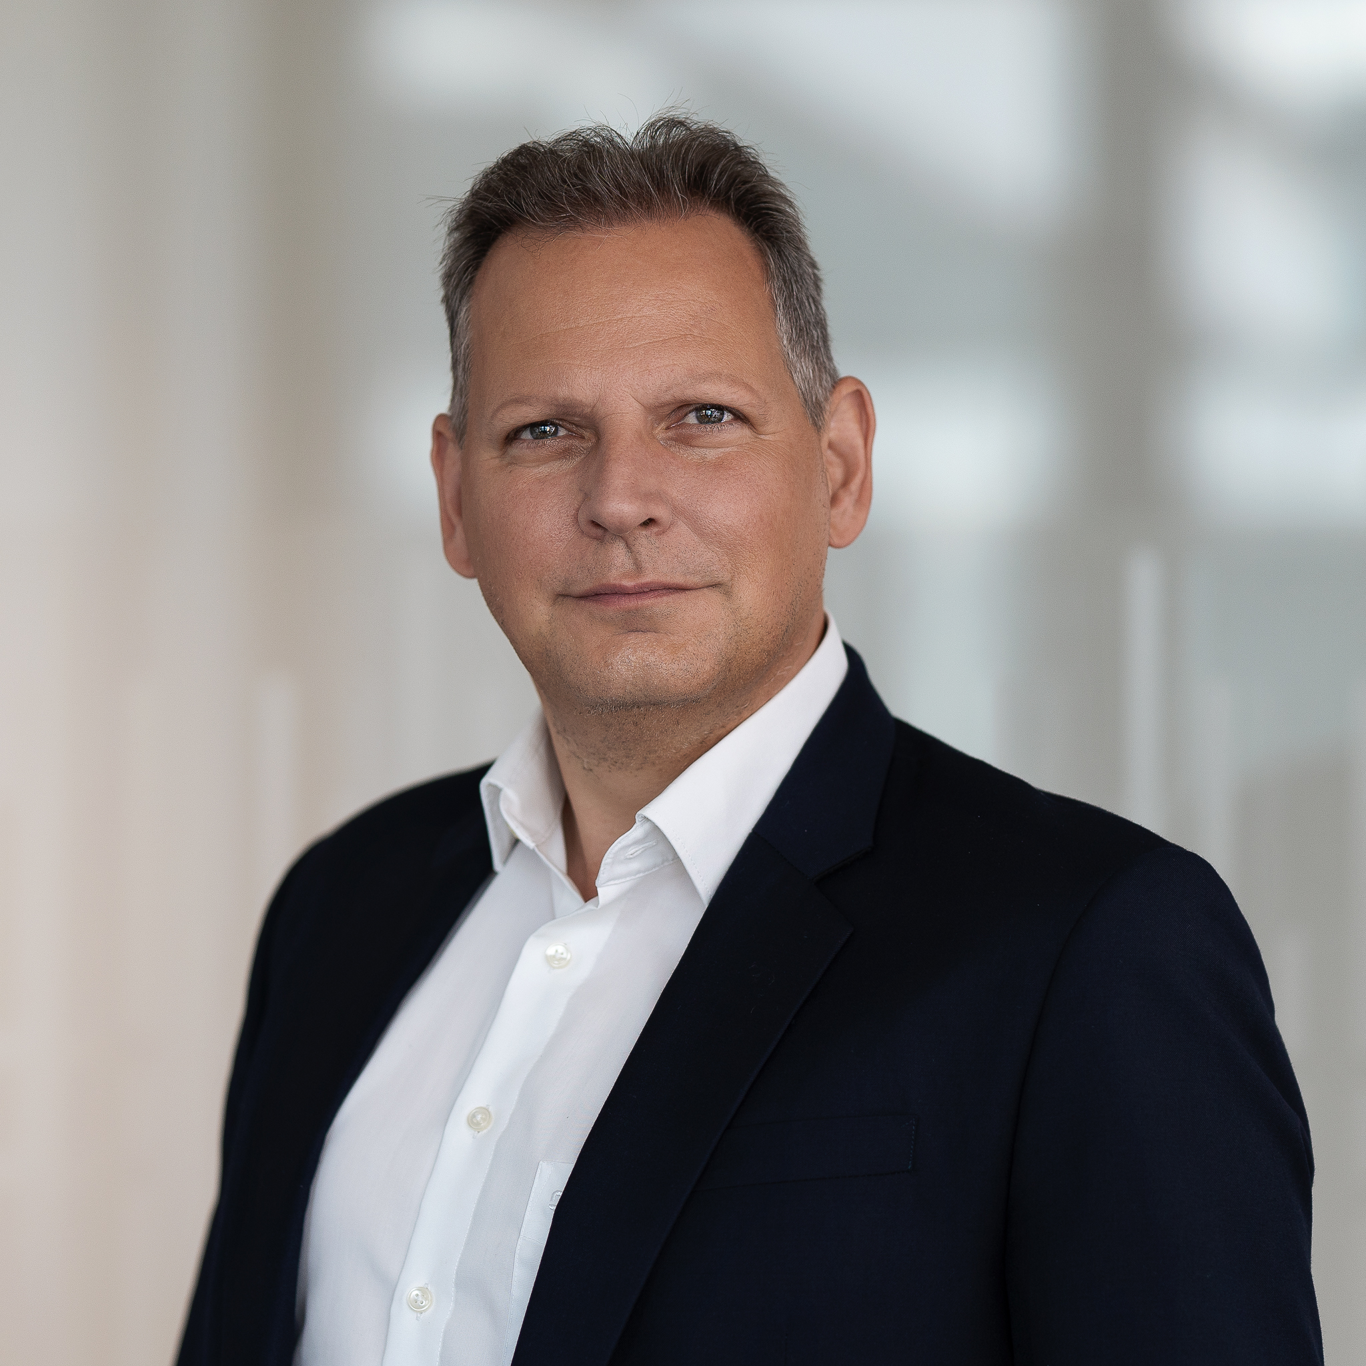
Harald Reisinger
Responsible for the operation, implementation, and roll-out of RNE's digital services
Chairman of the PRIME digital subgroup since 2019
RNE’s CFO:
oversees RNE's finances
coordinates the implementation of CEF and TEN-T funding projects for RNE and other companies in the railway sector
CIO, CFO
RailNetEurope (RNE)
association of European Rail Infrastructure Managers (IMs)
umbrella organisation that helps coordinate its Members' international processes in the areas of Capacity Management, Traffic Management, Corridor Management, IT and Sales & Legal Matters
RailNetEurope

Slide 5
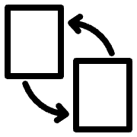
Data providers and Data consumers
Shareable
Several approaches possible to achieve the goal
Transportable
What are the needs of data consumers?
Which challenges are data providers facing?
Which requirements and challenges will we face in the coming years? How can we deal with them?
Railways are often still oriented towards 'national,' 'manual,' and 'annual' practices. How do we evolve towards a European, digital, and flexible approach?
‘Data and information are the gold of the future.’
Accurate
Relevant
Timely
Secure
Notes:
“Data and information are the gold of the future" is a statement often heard.
However, they must follow the principles defines by STARTS :​
❖ Sharable ​
❖ Transportable (from the archiving site) ​
❖ Accurate ​
❖ Relevant ​
❖ Timely ​
❖ Secure ​
​
There are several approaches to achieve this and we would like to understand better what the needs of the data consumers are, and which challenges the data providers are facing. Which requirements and challenges will we face in the coming years and how can we deal with them? Railways are still often oriented "national", "manual" and "annual", how do we move towards a European, digital and flexible approach?”​

Slide 6
Data Consumers
01

Slide 7
Julián Rojas​
Data Interoperability and Semantic Web researcher at Imec and Ghent University
Focus mainly on the design of cost-efficient system architectures for scalable and interoperable data exchange at Web scale
Applied research on transportation domain, including public transport, logistics and infrastructure
Collaborating with ERA for the last 4 years on developing semantic interoperability solutions such as the ERA Vocabulary and Knowledge Graph.
Researcher
Imec
Imec
World's leading independent nanoelectronics R&D hub
Combines nanotech expertise with data and AI

Slide 8
Julián Rojas
Interoperable and continuous data exchange on the Web with Linked Data Event Streams​
Linked Data Event Streams (LDES) specification as a uniform, scalable, domain-agnostic and semantically interoperable data exchange interface for the Web.
Publish historic and up-to-date data that allows consumers to travel back in time (e.g., for training AI models) and remain in-sync with a given data source.
Proof-of-concept that applied LDES to generate and continuously publish the ERA Knowledge Graph.
Notes:
Interoperable and continuous data exchange on the Web with Linked Data Event Streams​
​
Linked Data Event Streams (LDES) specification is an interoperable approach for data exchange on the Web. It will highlight its vision, benefits and challenges. Lastly, it will show the results obtained in a proof-of-concept that applied LDES to generate and continuously publish the ERA Knowledge Graph.​
​

Slide 9
Ingo Ritter​
Traveller information department of DB Group
Focus on data strategy, data governance and regulation of mobility data
Professorship for data protection and information law in the Faculty of Computer Science and Engineering at Frankfurt University of Applied Sciences
Current research in legal requirement management, i.e. the extraction of software development requirements from legal acts
Lead Business Engineer
DB Group
One of the world’s leading mobility and logistics companies
Designs and operates transport networks of the future
Integrated operation of traffic and railway infrastructure, and economically and ecologically intelligent connection of all modes of transport
DB Group

Slide 10
Ingo Ritter
Data regulation must make it easier to switch to railway as a sustainable mode of transport
The European Mobility Data Space could be useful as non-discriminatory provider of integrated and cross-border data
Receive operational data from IMs and RUs in a well-structured manner using state-of-the-art technologies as a basis for data cooperation in the retail sector
Data exchange in retail area for connected mobility
Deepened cooperation for rail as cross-border feeder transport to hub airports
Refinement of consumed raw operational data from a huge number of IMs and RUs is stressful and binds ressources
Highly integrated data is needed to provide a better service
Mobility data spaces could be useful as non-discriminatory providers of integrated and cross-border data saving multiple refinement efforts for RUs

Slide 11
Roland Klüber
Master in Business Information Systems, PhD in Management
CEO of Consilis, and Partner of Theron Advisory Group
focus on interim-management and IT-based business ecosystem transformations in multi-modal E2E logistics systems
supporting UIRR for almost a decade in
various multi-modal EU R&D projects (e.g. )
digital transformation initiatives & IT architecture design challenges
CEO
Consilis GmbH
Fostering client’s business model innovation and digital transformation in global health, energy, engineering & logistics business ecosystems
International Union for Road-Rail Combined Transport (UIRR)
industry association for the sector of Combined Transport in Brussels transposing needs to EU legislation, standardisation, services to sector, and R&D projects
100+ Combined Transport Operators, Terminal Operators, and partners
Consilis GmbH
representing UIRR s.c.

Slide 12
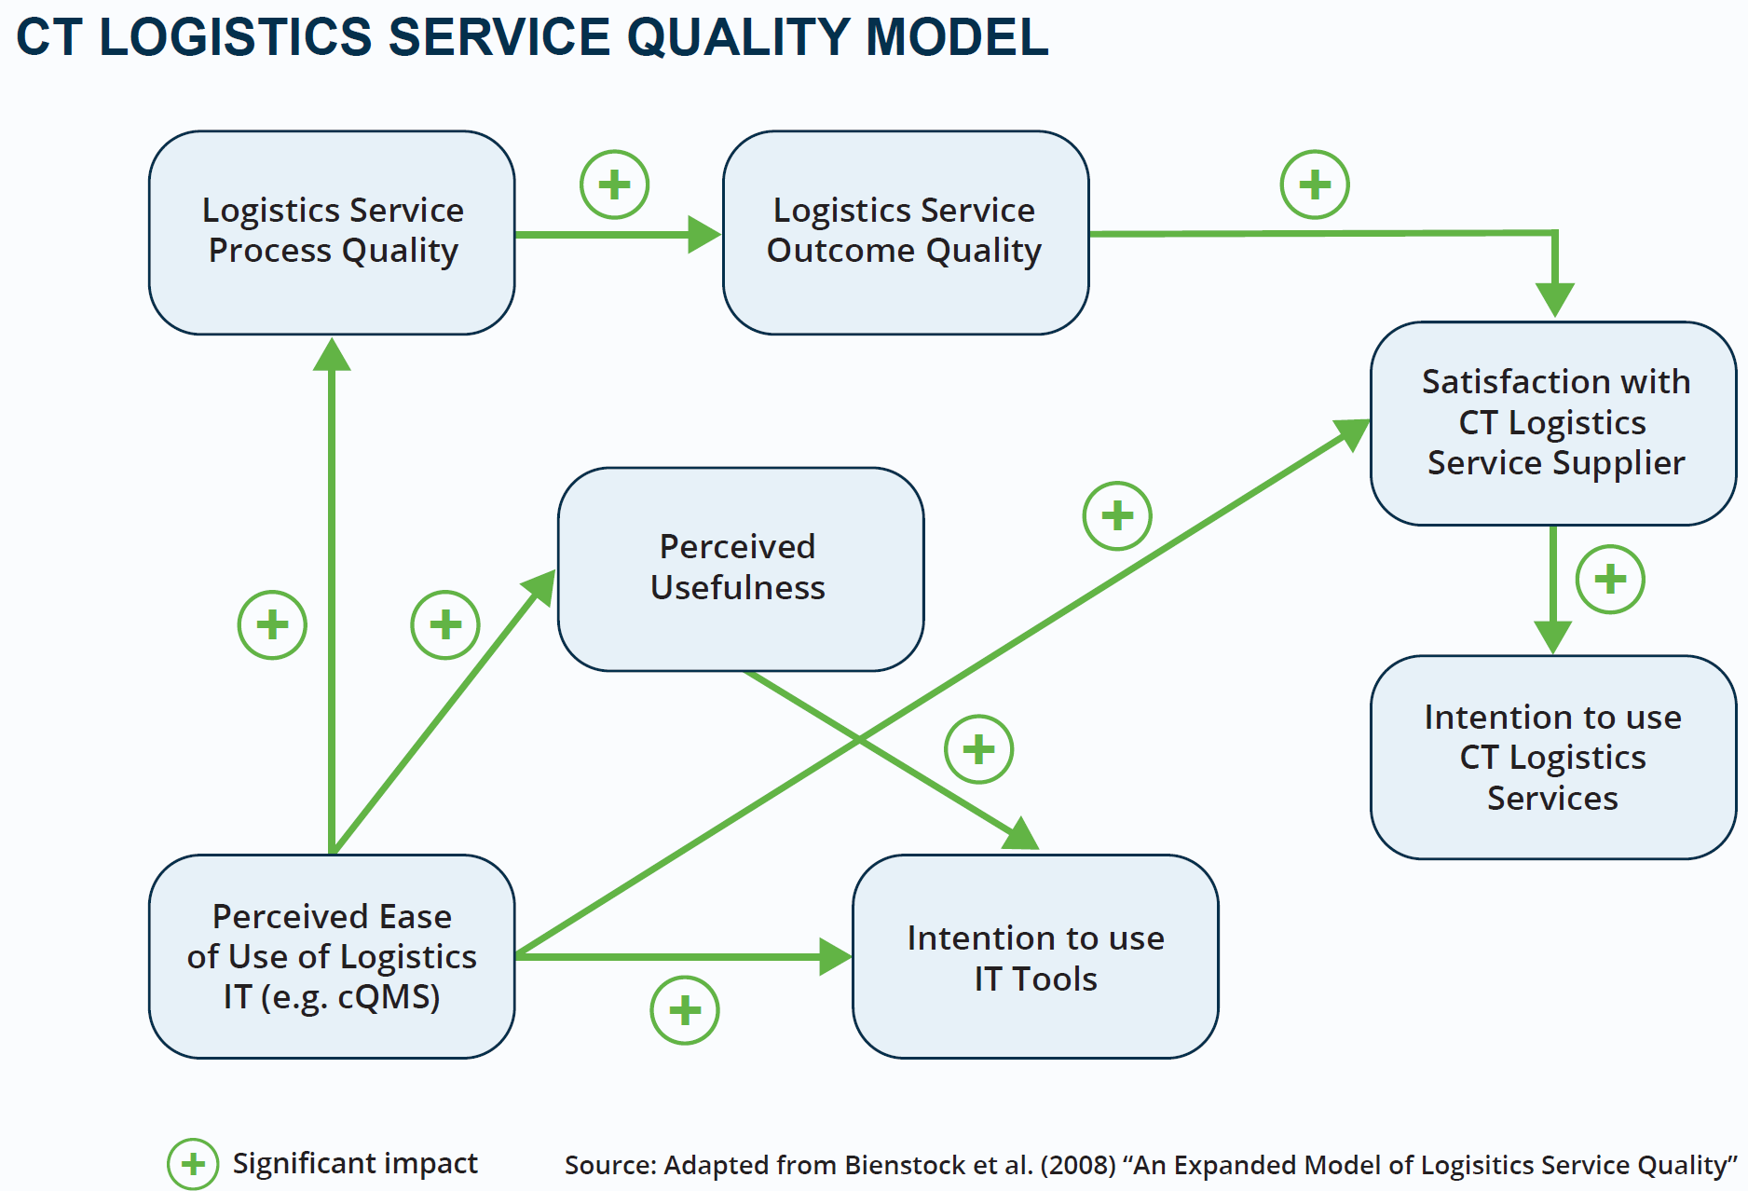
Reduced Interoperability Challenges of Combined Transport
WHY: Lever to increase attractiveness of CT (most carbon-free landbound transport mode)
Purpose: Enhance Data Interoperability & Service Quality
LSP
IM
TO
EDICT
CTO
RU
Many stakeholders
Gaps in end-to-end data exchange
Scarce & isolated quality information
Gap Closing
Shipper/ Consignee
Accurate + shared data as basis to improve service quality
CTO: Combined Transport Operator, TO: Terminal Operator, RU: Railway Undertaking
LSP: Logistics Service Provider, IM: Infrastructure Manager
Notes:
Enhance Data Interoperability for all CT stakeholders – overcome E2E data gaps and focus on integrating data sources. Data quality is critical. Standardisation of processes, transaction data, master data and reason codes for interruptions and delays is not mature and widely used today. EDICT provides solution paths in several areas to overcome mental silos and “pockets of data” (e.g. reason code harmonisation).

Slide 13
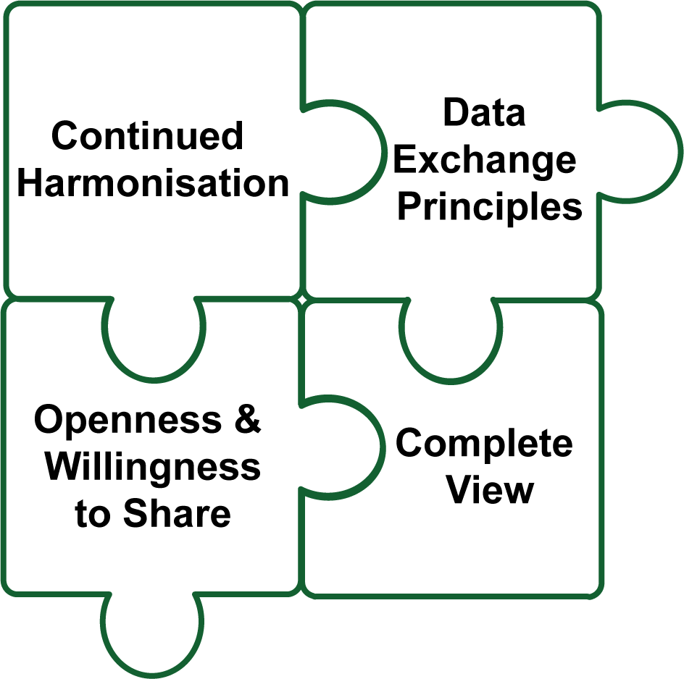
Roland Klüber
Building blocks for multi-modality
Continued harmonisation of data and semantical interoperability of IT systems and IT platforms
Foster multilateral data exchange principles (e.g. data for data, federated data governance, EMDS for freight)
Increase openness & willingness to information sharing facilitating modal choices of shippers towards rail
Complete view: Information about goods, safety, CO₂ footprint with sufficient digital security
E2E interoperability bridges towards increasing data value
Provide an international train number (surrogate)
Value of data for customers: transform data to information (“leading to action”) for terminals, CTOs and shippers – easily accessible and cost-efficient!
Increase plannability (e.g. avoid business ecosystem irritations if legs are not bookable or traceable)
Silo-crossing prevention and exception management processes increasing responsiveness

Slide 14
Data Consumers
"Which are the needs of the Data Consumers"

Slide 15
Polling Question - slido
"Which organisation to do you represent in this meeting?“
* European Body
* Infrastructure Manager
* Railway Undertaking
* Terminal/Service Facility
* Other
"Which of these factors contributes the most to a higher value of data?
* 100% data quality
* Data centrally available for all (machine readable, standardised format,...)
* Automated data genaration and exchange

Slide 16
Data Providers
02

Slide 17
Mathias Vanden Auweele​
15 years of experience leading business data and digitalisation projects at Infrabel
Ex-national representative at CENELEC TC9
EIM ex-speaker for ENE WG
Inventor and gardener at home
European Union, Railway, Sustainability and Linked Data supporter
Teamlead Data Centricity
Infrabel
Belgian railway infrastructure manager
Owns, builds, maintains and upgrades the Belgian railway network, makes its capacity available to railway operator companies, and handles train traffic control
Infrabel - Belgium

Slide 18
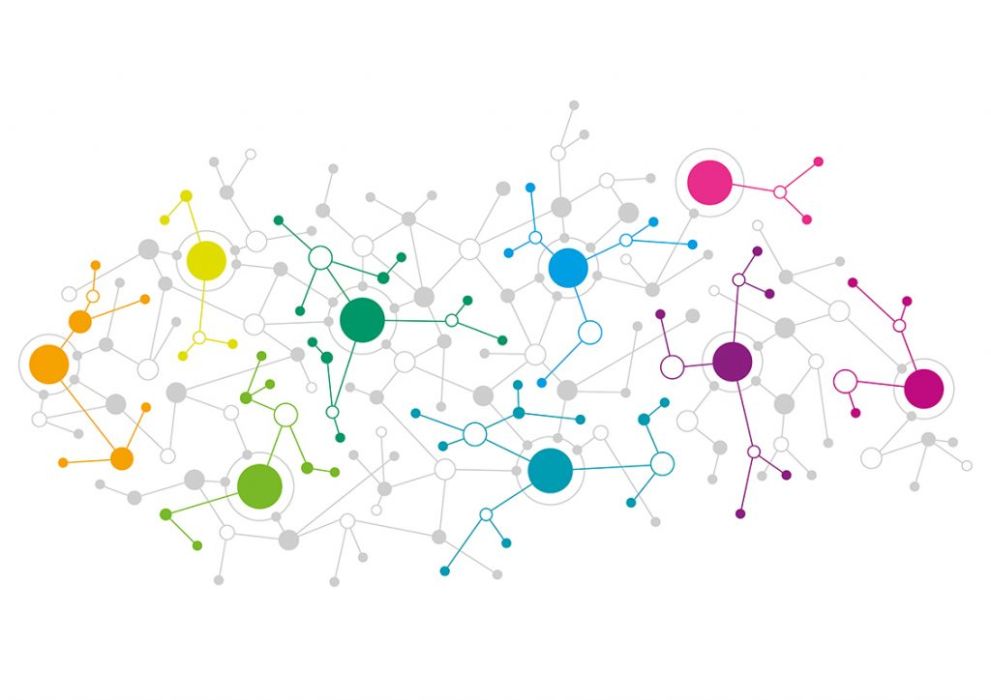
Mathias Vanden Auweele
THE PROCESSES
Data pipelines
Manage the data aspect in your business processes
The data producer publishes structured data at the right time in the right model
Manage the context in which data changes
THE DATA
Enterprise data model (EDM)
Know what you are talking about
Semantics, relations, constraints
Enterprise Ontology
Standardise
THE TECHNOLOGY
THE PEOPLE
Data centric platform
Data modelled according to the EDM
Generic data functions
Knowledge graph
Golden record
Enterprise data helpdesk
Help employees with data questions
Build an enterprise competence center
Documentation is OK, helping is better

Slide 19
Gilles Peterhans
Study of finance and economics at the University of St. Gallen in Switzerland
various operating positions in the railway industry
management experience as CEO of a rolling stock leasing company and a railway undertaking
Secretary General of UIP – International Union of Wagon Keepers, since January 2013
Secretary General
UIP – International Union of Wagon Keepers
umbrella association of national associations from fourteen European countries with seat in Brussels
Representing more than 250 freight wagon keepers and ECMs with more than 245,000 freight wagons, performing 50 % of the rail freight tonne-Kilometres throughout Europe.
UIP wants to secure on the long term the future of rail freight transport.​
UIP
International Union for Wagon Keepers
Notes:
Mr. Gilles Peterhans studied finance and economics at the University of St. Gallen in Switzerland. After he graduated, he transitioned through various field of operating positions in the railway industry and acquired extensive management experience as CEO of a rolling stock leasing company and a railway undertaking. Since ​
January 2013, he acts as Secretary General of UIP – International Union of Wagon Keepers.​
​
The UIP – International Union of Wagon Keepers, with its seat in Brussels, is the umbrella association of national associations from fourteen European countries, thus representing more than 250 freight wagon keepers and ECMs with more than 245’000 freight wagons, performing 50 % of the rail freight tonne-Kilometres throughout Europe. UIP wants to secure on the long term the future of rail freight transport.​

Slide 20
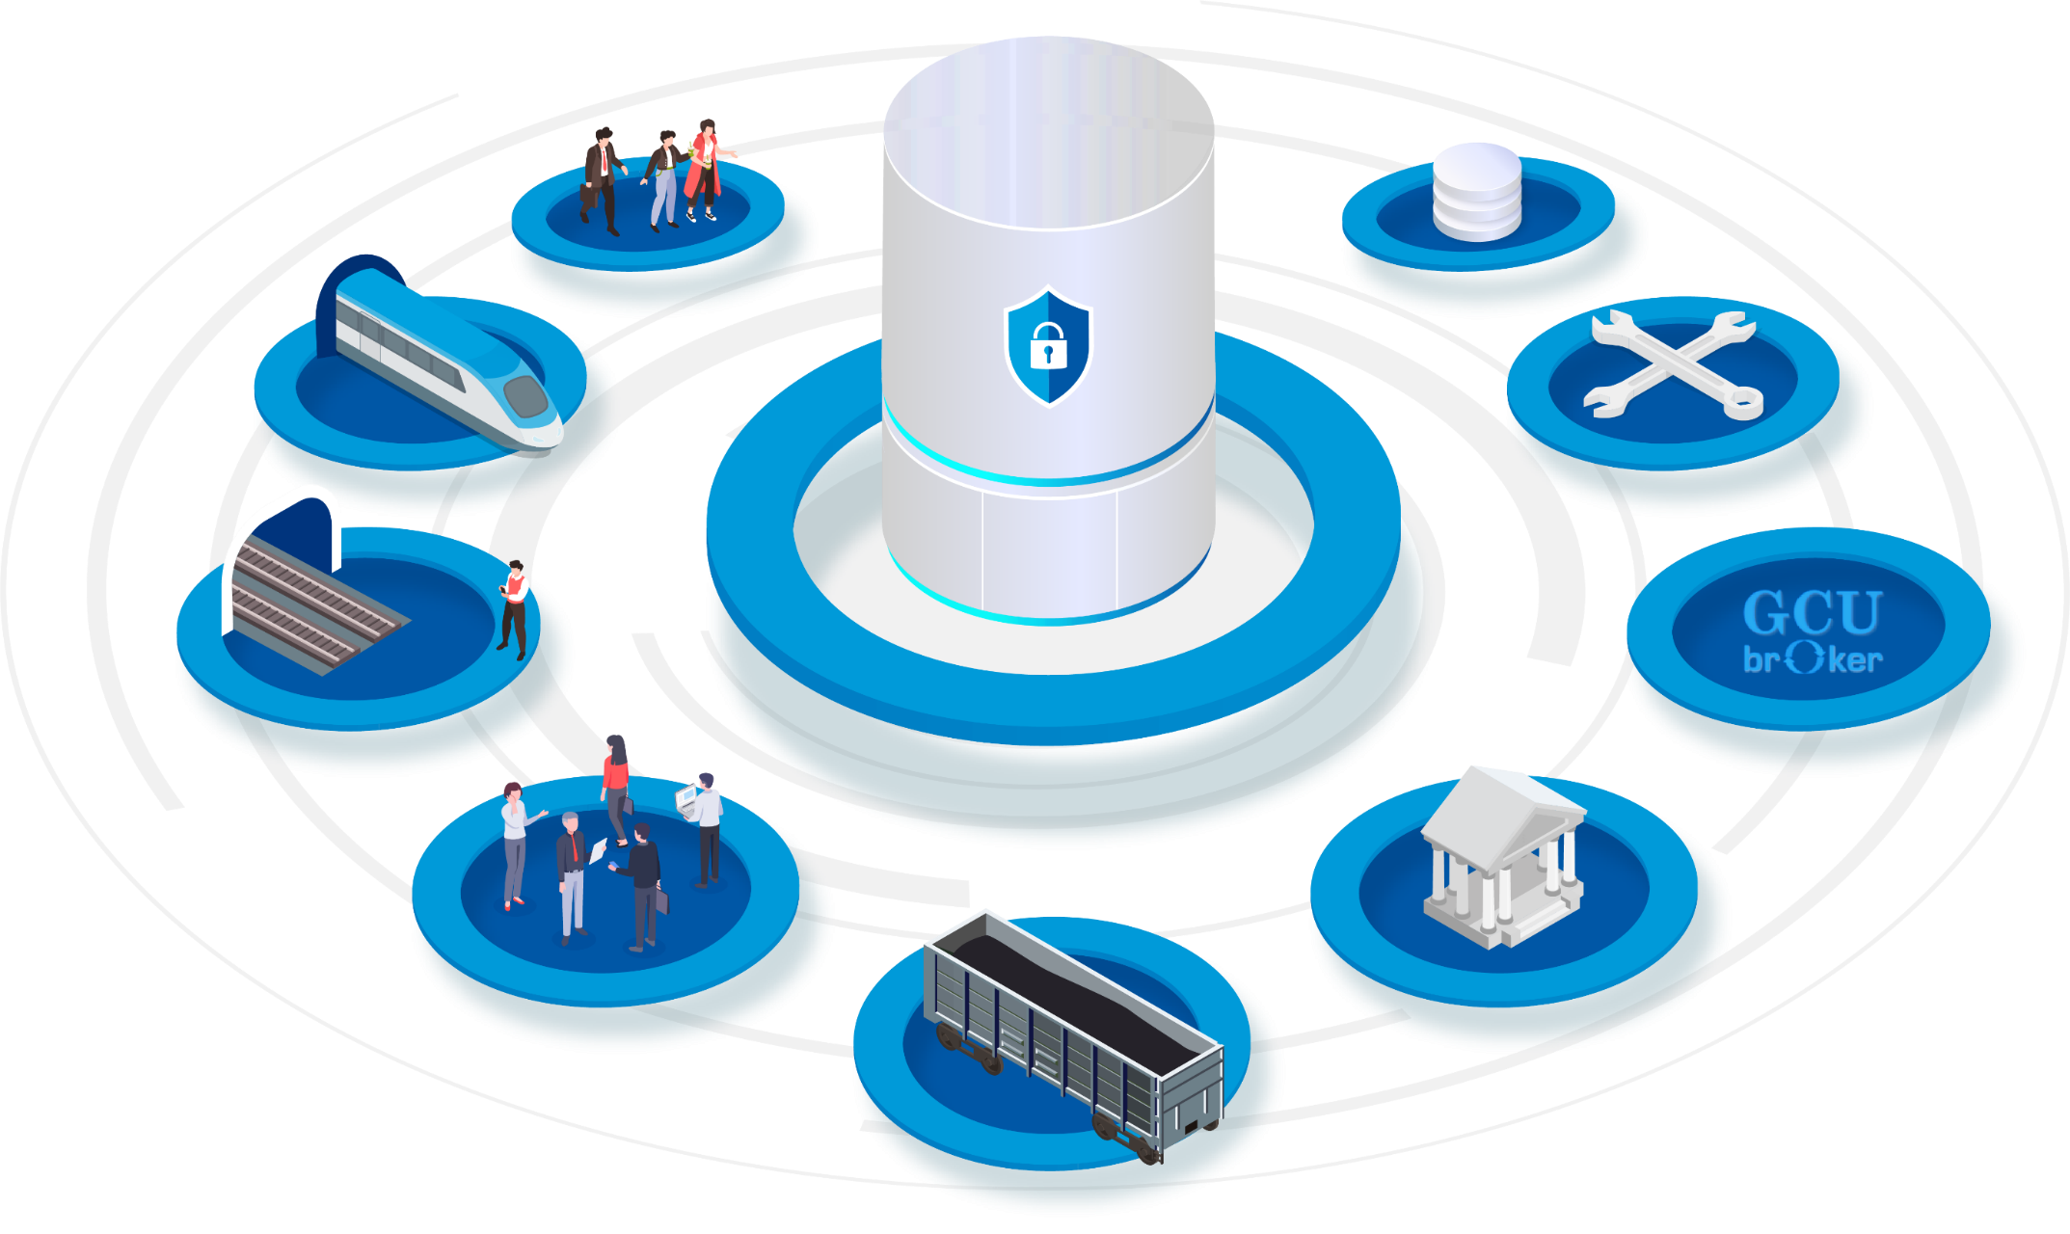
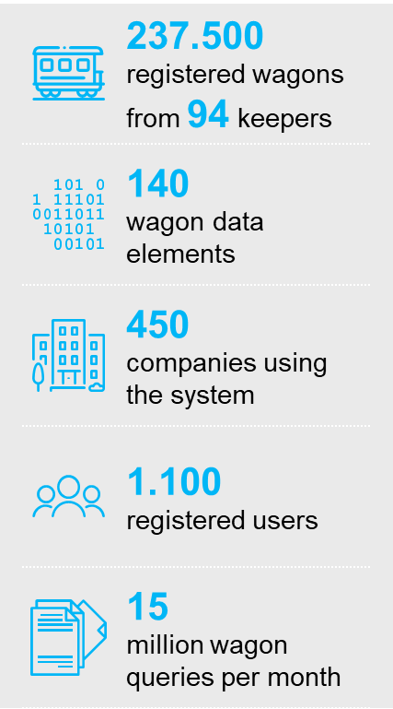
Gilles Peterhans
RSRD² is the source for wagon reference data

Slide 21
Gilles Peterhans
RSRD² allows easy access to freight wagon data

Slide 22
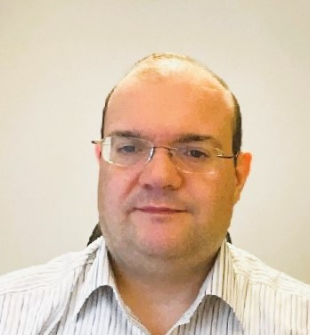
Miguel Figueres-Esteban
Telecommunications Engineer and PhD in Psychology
20 years of experience in railway safety.
Area Head of Digital Transformation and Training at Renfe
Developing a Safety Enterprise Architecture for advanced risk management
Developing a business knowledge graph to support safety data governance
Renfe Group
leader in rail transport for passengers and goods
point of reference in the mobility sector in Spain
5,000 trains every day in Spain, and more than 500 million passengers a year
about 15,000 committed employees who are proud of their work and the most outstanding rates for punctuality, quality and satisfaction
Renfe is working to make the train the star of mobility in Spain, and expand business across borders​
Area Head of Digital Transformation and Training
Renfe
Notes:
Miguel is Telecommunications Engineer and PhD in Psychology. In 2019 Miguel joined Renfe as the Head of Human Factors. Currently he is the Area Head of Digital Transformation and Training, focused on the development of a Safety Enterprise Architecture for advanced risk management. ​
​
Renfe Group is the leader in rail transport for passengers and goods and a point of reference in the mobility sector in Spain. With 5,000 trains running every day in Spain, more than 500 million passengers a year, about 15,000 committed employees who are proud of their work and the most outstanding rates for punctuality, quality and satisfaction, Renfe is working to make the train the star of mobility in Spain and, at the same time, expand our business and cross borders​

Slide 23
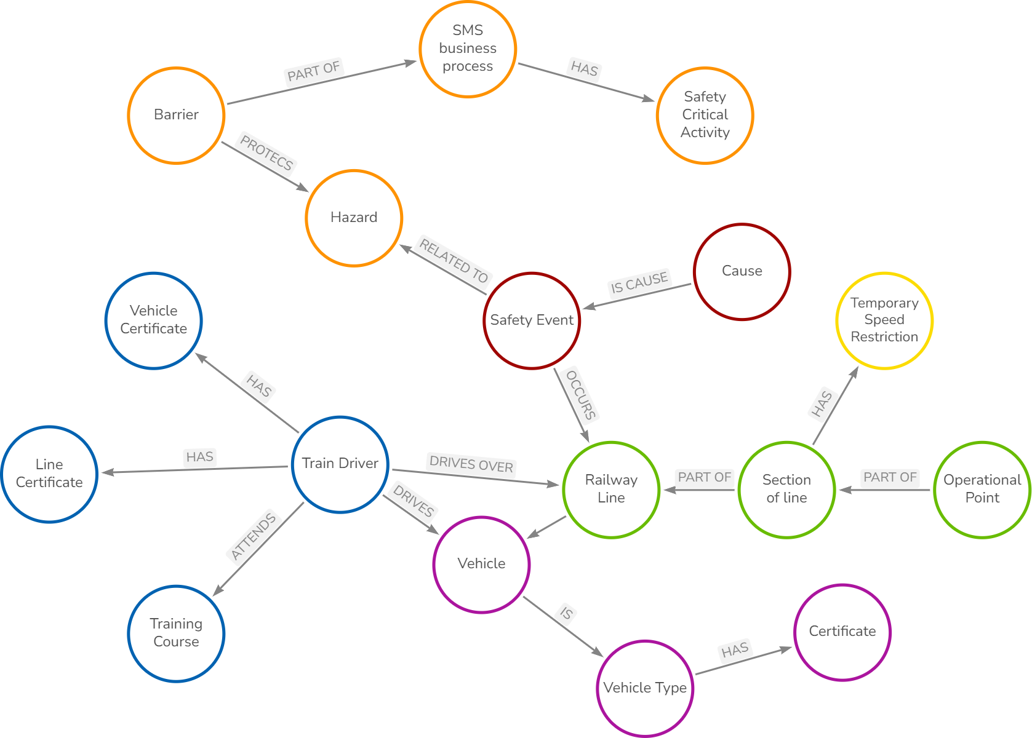
Miguel Figueres-Esteban
Safety Knowledge Graph as an enabler for Dynamic Risk Management at Renfe
Strategic project of the Renfe digital transformation programme
for Dynamic Risk Management (DRM)
to assess the safety level and the safety performance of the Safety Management System according to the CSM ASLP
DRM requires advanced data acquisition systems - Renfe is developing a Safety Enterprise Architecture (SEA)
core of the SEA is a semantic layer based on a Safety Knowledge Graph aligned with ERA ontologies
to enable the right integration of different data sources at Renfe
to facilitate data exchange with future European safety systems such as the Information Sharing System (ISS)
Notes:
Renfe is developing an ambitious digital transformation programme to pave the way for Dynamic Risk Management (DRM) to assess the safety performance of Safety Management Systems. DRM requires of advanced data acquisition systems and Renfe is developing a Safety Enterprise Architecture (SEA) for it. This presentation shows how the core of this SEA is a semantic layer based on a Safety Knowledge Graph to enable the right integration of different data sources at Renfe.

Slide 24
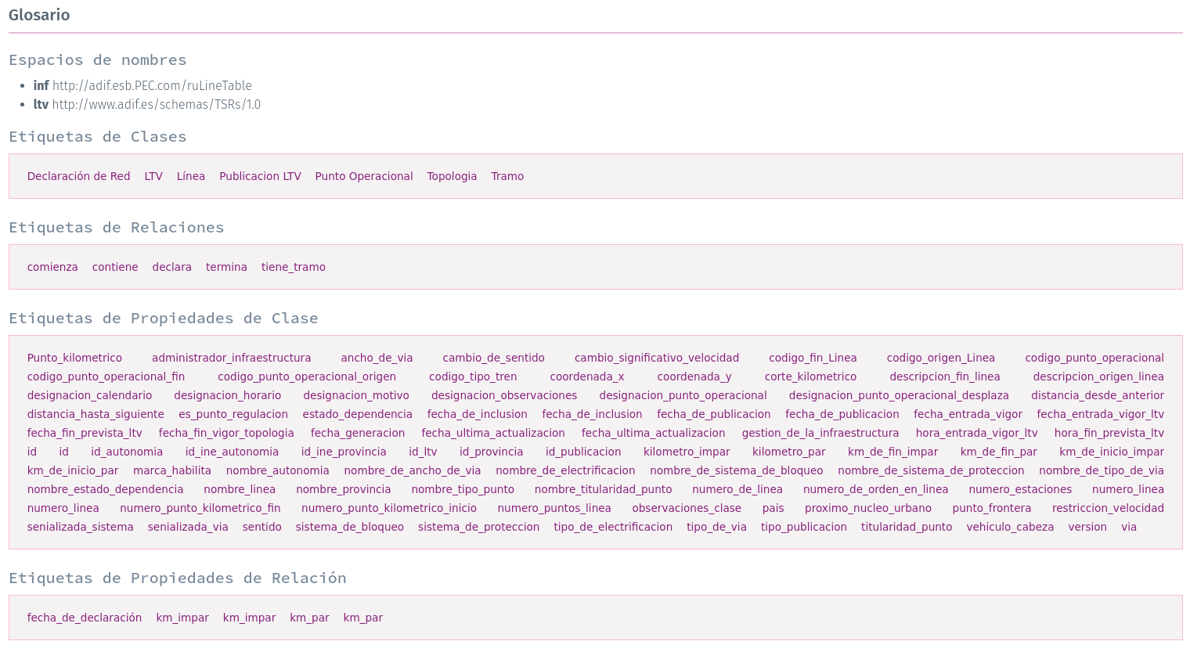
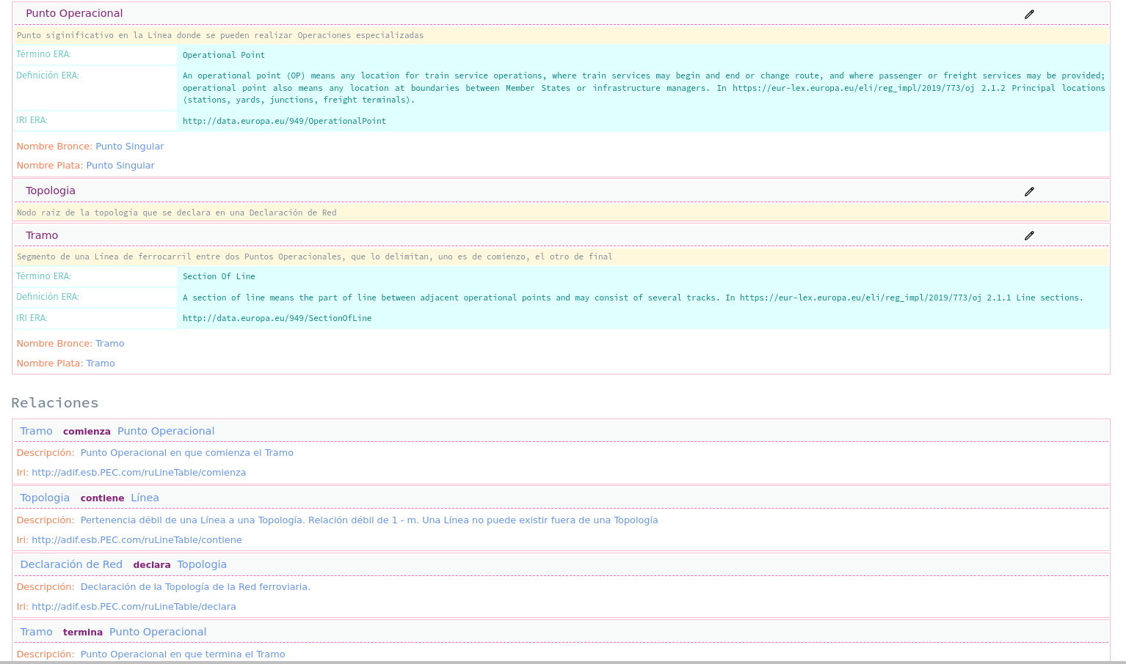
Miguel Figueres-Esteban
Working on Property Graph and RDF
Renfe Vocabulary
ERA Vocabulary
Notes:
Renfe is developing an ambitious digital transformation programme to pave the way for Dynamic Risk Management (DRM) to assess the safety performance of Safety Management Systems. DRM requires of advanced data acquisition systems and Renfe is developing a Safety Enterprise Architecture (SEA) for it. This presentation shows how the core of this SEA is a semantic layer based on a Safety Knowledge Graph to enable the right integration of different data sources at Renfe.

Slide 25
Data Providers
"Which are the challenges of the Data Providers"

Slide 26
Polling Question
"Which organisation to do you represent in this meeting?“
* European Body
* Infrastructure Manager
* Railway Undertaking
* Terminal/Service Facility
* Other
"Which barrier do you consider the most important one the sector is facing today?”
* Lack of governance on the data level
* Lack of vision and regulatory frameworks on data (open data, dataspaces,...)
* Lack of standardisation of data formats (ontology, TSIs,...)
* Lack of financial means to implement

Slide 27
Data Providers and Data Consumers
THANK YOU FOR YOUR ATTENTION

Slide 28
Data Providers and Data Consumers
"Which enablers could facilitate data providers and consumers "

