Slide 1
UIRR Contribution @ Rail Data Forum

Slide 2
Agenda
Workshop: Telematics Freight
Back-up

Slide 3
Meeting Cascading Requirements Challenge
Regulators on EU and national level
Shippers’ Requirements
Freight Forwarders’ Requirements⁴
Rail freight services
Reliable international transports¹
Price competitiveness¹
Responsiveness to planning requests¹
Standardised, complete & actual information¹ ²
Greening freight (e.g. CountEmissionsEU)^{2, 3}
Supply chain visibility
Improved interoperability between modes & stakeholders
Data sharing & quality (accuracy, timeliness)
Standardised KPIs & reporting on punctuality & quality
Standardised exception & prevention management
Sources: ¹ https://europeanshippers.eu/policies/rail-transport/
² Own consulting practice experience
³ https://www.europarl.europa.eu/RegData/etudes/BRIE/2023/757562/ EPRS_BRI(2023)757562_EN.pdf
⁴ ECTA. (2021). ECTA Best Practice Guideline: Transport visibility within Bulk Chemicals.

Slide 4
Meeting Cascading Requirements Challenge
Regulators on EU and national level
Rail freight services
CTOs’ Requirements
Freight Forwarders’
Requirements
from EDICT project:
Standardisation of time stamps
Synchronisation between CT and rail systems (terminals)
Recognition of CTOs as legitimate actors
Exchanging relevant information with LSPs, IMs, RUs, IT platforms
Harmonised reason codes (delays, disruptions)
from TSI Telematics:
Exchange of ETA, ETD
All stakeholders involved in the transport are legitimate
How: 1) Faster alignment and synchronisation to close gaps (e.g. shunting yard integration)
2) Cost efficient IT platform interoperability
3) Specific rail-road ecosystem initiatives on road-blockers (e.g. international train number)
4) Standardisation and harmonisation of data (e.g. reason codes between CT and RU/IMs)

Slide 5
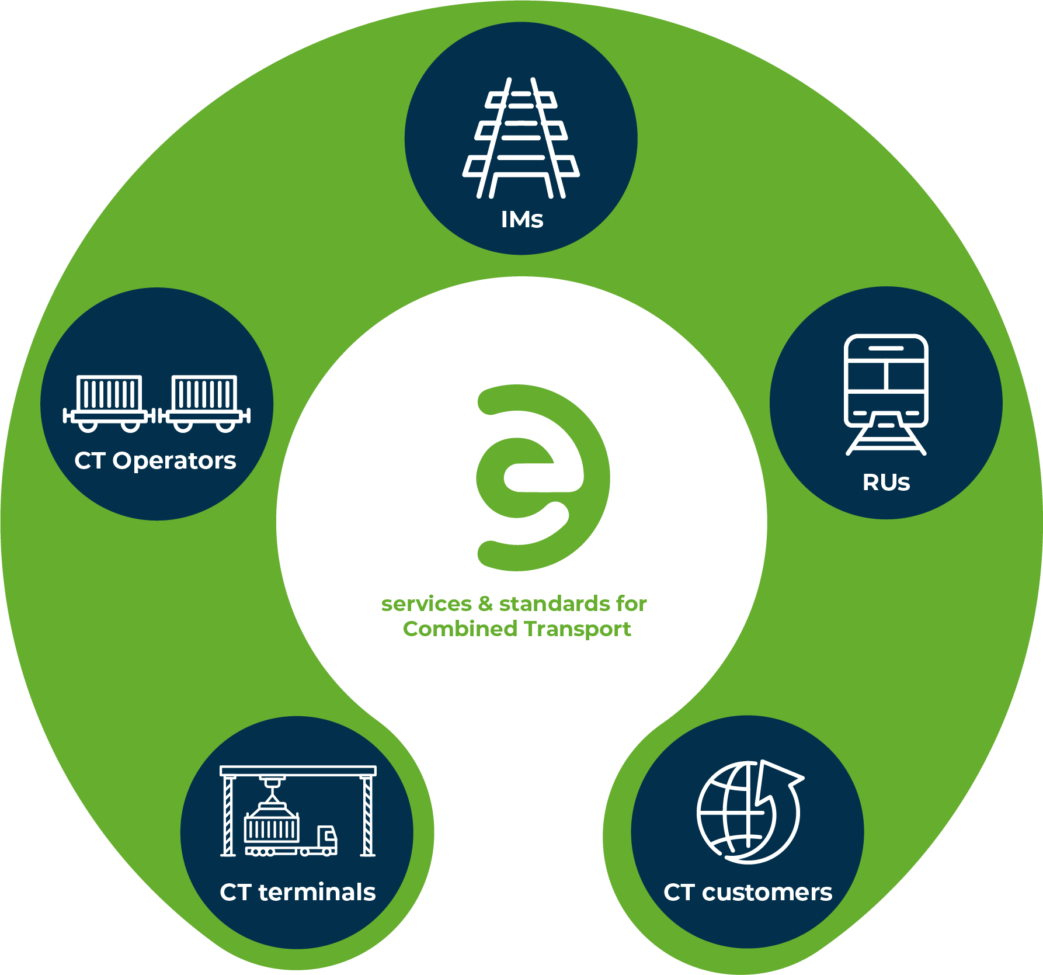
EDICT Interoperability Push: Digital Collaboration & Collaborative QMS (cQMS)
Addressed interoperability levels:
Business processes (quality & punctuality)
Standard development
EDIGES¹ extensions (HLR, MAD, TC, etc.)
TAF TSI / TSI Telematics
Reason code harmonisation
Master data exchange enhancements
IT Platforms
¹ EDIGES: Electronic Data interchange for Intermodal Global European Standard managed by EDIGES consortium of relevant CTOs to facilitate communication standardisation with LSPs and rail stakeholders
Notes:
Interoperability gaps to be closed on these levels…

Slide 6
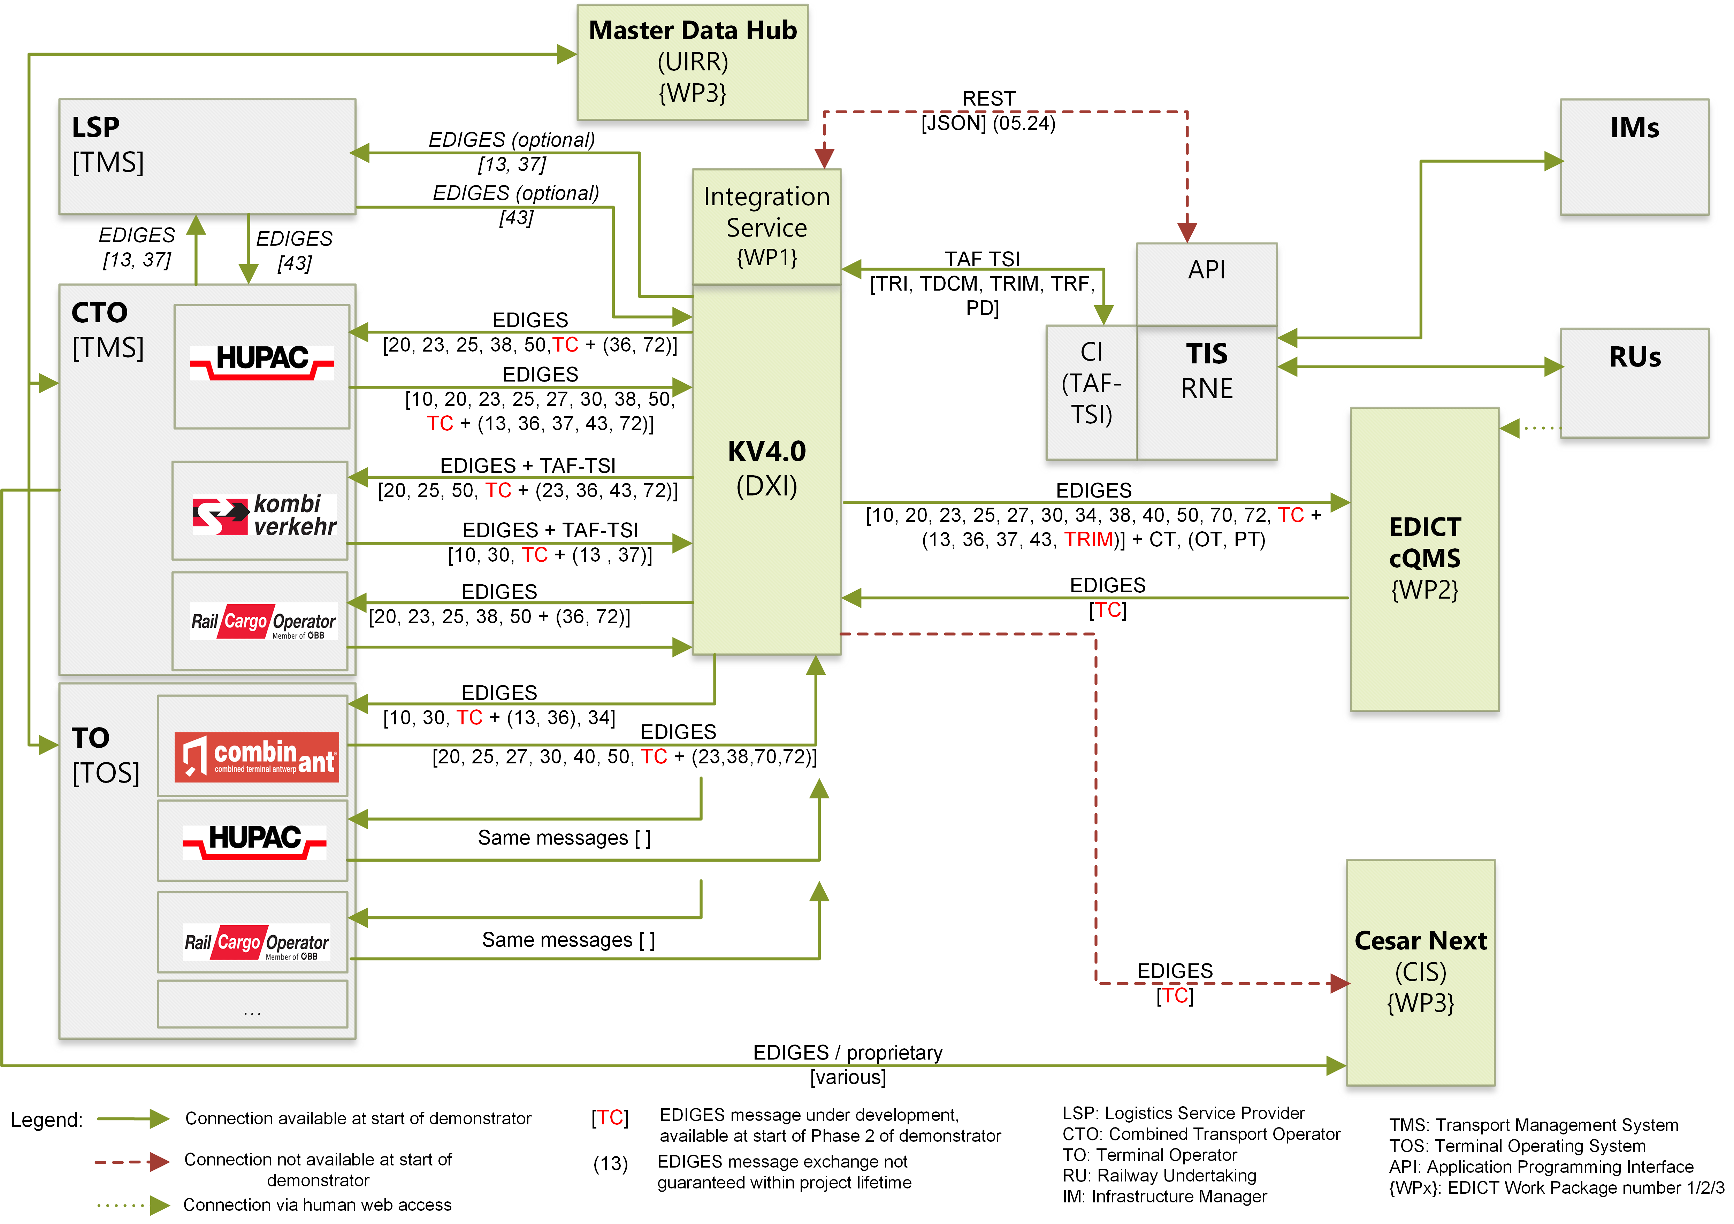
EDICT Results (in progress)
Five interoperable IT platforms enrich Combined Terminal digital connections to CTOs, IMs & RUs via
Increase compliance with TAF TSI / TSI Telematics & interoperability
Introduce cQMS processes & reports
- Harmonised reason codes
Collaborative reason code reconciliation
Collaborative reporting
Enhance end-to-end data exchange quantity
Increase interoperability scope & adoption
(End-2-End Interoperability Increase & Adoption within Combined Transport) EDICT Leverage Project Proposal

Slide 7
EDICT result: Collaborative reconciliation process (RU-CTO)
1
2
Detection of non-conformity / disruption
Parties involved enter reason or cancellation code into local TMS or cQMS
3
Per non-conformity RU & CTO collaboratively decide on reason code, originator & delay in cQMS

Slide 8
Agenda
Workshop: Telematics Freight
Back-up

Slide 9
Future development direction of rail information exchange from a business ecosystem view
Be not fearful, but actively embracing change and opportunities
Not sharing all information, but the relevant parts to make train attractive to shippers
Remove hurdles to allow that network effects happen (overcome chicken and egg problem)
Improve interoperability of platforms (RNE TIS, DXI KV4.0, Port Community Systems etc.) and standards (TSI Telematics, EDIGES, etc.)
…

Slide 10
Gaps
Terminal Operator readiness to exchange data with IMs/RUs is very low
International train number (-> changing national train numbers lead to visibility loss) – not thinkable in aviation!
Focused information exchange for terminals (not e-mails for all status updates)
…

Slide 11
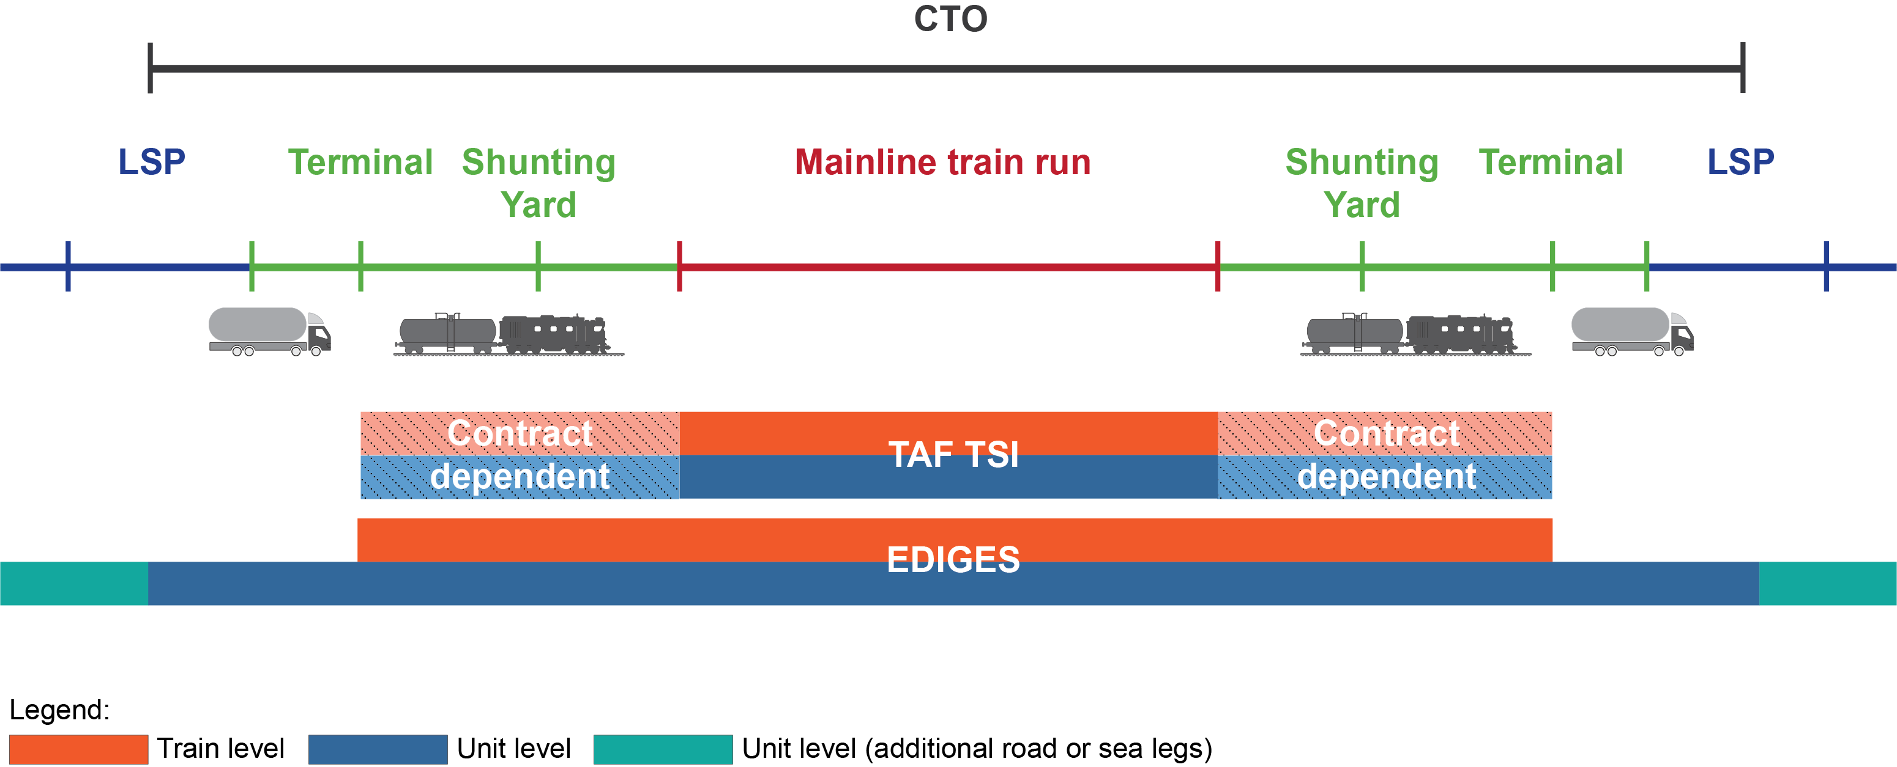
cQMS covers terminal-to-terminal
Outlook will contain door-to-door inclusion opportunities

Slide 12
Conceptual view of reason coding within cQMS
EDIGES
MAPPING
MAPPING
CTOs
…
RU
…
Harmonised Reason Codes CT
IM
TOs
…
txt
CESAR
RUs
TAF-TSI
EDIGES
CTO
TO
IMs
…
…
LSP
Shunting
Yards
…
…
Shipper

Slide 13
Standards -> Interoperability ->Willingness to share -> Interfaces to share
Interoperability must be aligned on several levels
1
2
3
4
Levels:
Views:
Key Interoperability Objects:
1. Organisational
Ecosystem
Interaction and governance rules, responsibilities, value creation, capturing and distribution, incentives & collaboration
Privacy, human rights, equity, accessibility, fairness, openness
Customer orientation, ease of use, capturing data to improve, high availability and responsiveness
Continuous learning and adaptation to new learnings and changing needs
Digital and physical communication and exchange standards (e.g. authorization, certification, pressure)
Standardisation and harmonization of ontologies, metadata for technical and commercial data exchange
Syntactical standardisation and mapping services for AI-based optimisations
Safety infrastructure (physical), security standards (digital)
Multi-modal, valves, pressure and filling-station standards…
Identify open and willing to act business-public-ecosystem (geographic/modality improvement scope)
Assess interoperability inefficiencies (partner, governance, communication, legal, data, physical, IT systems, etc.)
Provide recommendations to overcome deficits via effective interventions
Identify pilot project
Manage pilot project
Scale to full complexity / regional scope
Embed learning & adaptation mechanisms
Legal / Regulatory
Shippers & LSPs requirements to manage their business
Governmental requirements (e.g. eFTI, customs)
Sector internal requirements
2. Processes & Resources Application / Assets / HW
Customer-facing
Service Provider-facing
3. Communication
Protocols / Connections
4. Data
Semantics
Syntax
5. Infrastructure Technology
(Assets, HW & SW)
Security
Technical Infrastructure
Source: adapted from Nair/Klüber (2020) DIGITAL CONTACT TRACING INTEROPERABILITY: BALANCING PRIVACY AND PUBLIC HEALTH CONCERNS TO FIGHT COVID-19, In Diplomatic Courier (25.09.2020) https://www.diplomaticourier.com/posts/digital-contact-tracing-interoperability-balancing-privacy-and-public-health-concerns-to-fight-covid-19

Slide 14
Thank you for your participation

