Slide 1
Data Providers
02

Slide 2
Mathias Vanden Auweele​
15 years of experience leading business data and digitalisation projects at Infrabel
Ex-national representative at CENELEC TC9
EIM ex-speaker for ENE WG
Inventor and gardener at home
European Union, Railway, Sustainability and Linked Data supporter
Teamlead Data Centricity
Infrabel
Belgian railway infrastructure manager
Owns, builds, maintains and upgrades the Belgian railway network, makes its capacity available to railway operator companies, and handles train traffic control
Infrabel - Belgium

Slide 3
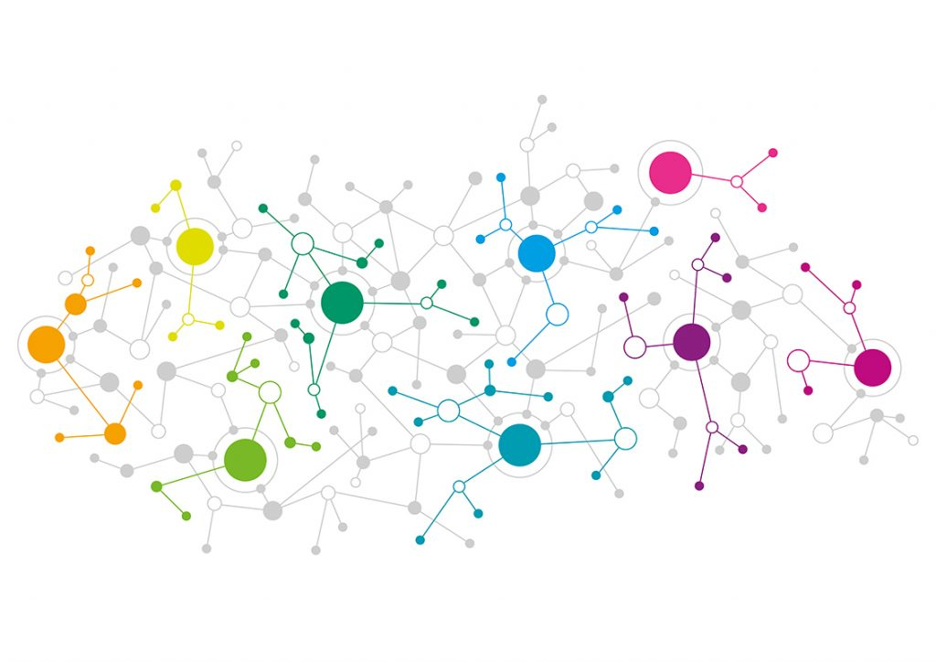
Mathias Vanden Auweele
THE PROCESSES
Data pipelines
Manage the data aspect in your business processes
The data producer publishes structured data at the right time in the right model
Manage the context in which data changes
THE DATA
Enterprise data model (EDM)
Know what you are talking about
Semantics, relations, constraints
Enterprise Ontology
Standardise
THE TECHNOLOGY
THE PEOPLE
Data centric platform
Data modelled according to the EDM
Generic data functions
Knowledge graph
Golden record
Enterprise data helpdesk
Help employees with data questions
Build an enterprise competence center
Documentation is OK, helping is better

