Slide 1
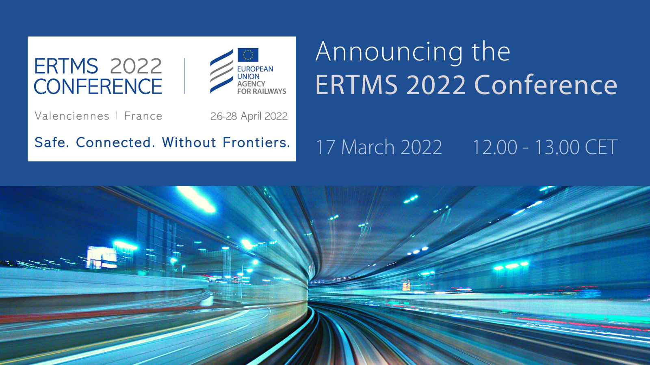
Announcing the ERTMS 2022 Conference
17 March 2022 – Free ERA Webinar

Slide 2
Speakers
Josef Doppelbauer
Executive Director
Matthias Ruete
Pio Guido
European TEN-T Coordinator for ERTMS
Head of Railway Systems Department
Monika Heiming
Executive Director
Mark Topal-Gökceli
CTO ÖBB

Slide 3
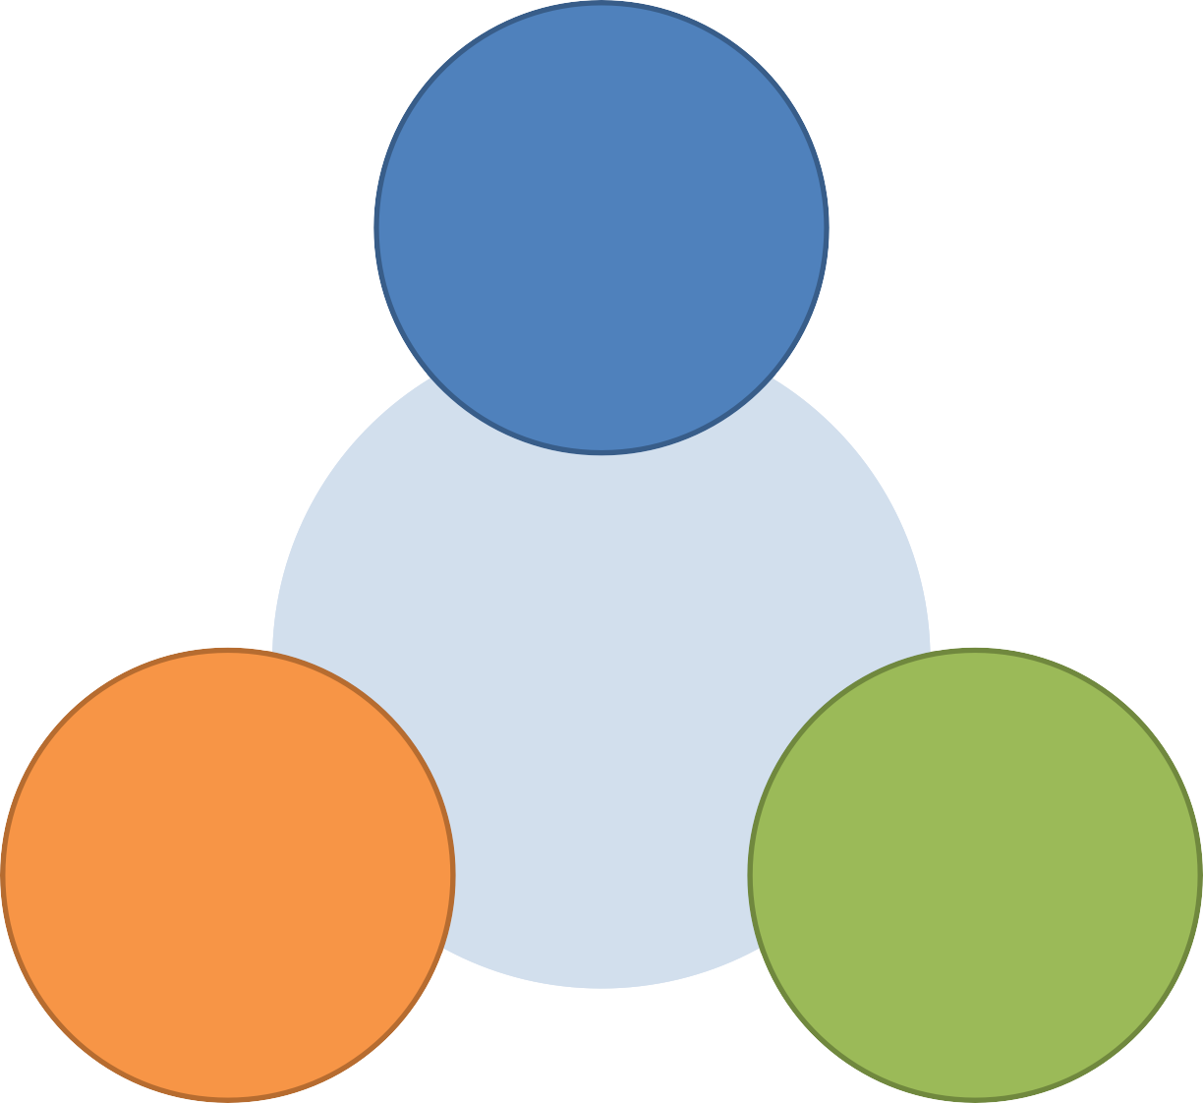
End-to end Interoperability
ERTMS: the Rationale
Removal of cross-border burden and cost
More competition on the railway market
Level playing field with road transport
ERTMS
Standardisation
Performance
Universal system
Standardised products
One system, multiple suppliers
Opening worldwide market Opportunities for suppliers
Improved safety
Increased capacity and speed
Increased reliability and reduced journey times
Reduce costs (capital, maintenance, and training)
Notes:
A key advantage of ERTMS, compared with legacy fragmented national system, is the huge amount of return from experience available with ERTMS – we have lessons learned that are valuable for the whole EU rail community of suppliers, clients and service providers, in terms of engineering, operations, maintenance and migration, market conditions, all along the system life cycle – this amount of collective learning and building on experience is simply not available with legacy national systems.

Slide 4
Engaging. Participatory. Dynamic.
Agenda Insight
DAY 1 | 26 April: Registration, introductory remarks, 10 workshops
DAY 2 | 27 April: ERTMS Past – Present –Future, 3 Sessions, Round table
and conclusions
Session I: 2000 – 2022 ERTMS Achievements
Session II: TSI CCS Revision Package 2022
Session III: System evolution towards digital rail
DAY 3 | 28 April: ERTMS Projects Return of Experience
Session IV: Feedback from the ERTMS Projects | Part I
Session V: Feedback from the ERTMS Projects | Part II
Session VI: Window of opportunity

Slide 5
Speakers
Josef Doppelbauer
Executive Director
Matthias Ruete
Pio Guido
European TEN-T Coordinator for ERTMS
Head of Railway Systems Department
Monika Heiming
Executive Director
Mark Topal-Gökceli
CTO ÖBB

Slide 6
ERA ERTMS 2022 webinar
EIM’s view on ERTMS
Date: 17th March 2022
Time: 12.00 – 13.00
Format: virtual
Speaker: Monika Heiming, EIM aisbl

Slide 7
Reflection on the TSI CCS revision process:
EIM supports the revision process (there was a higher level of ambition - e.g. FRMCS):
ERTMS remains more than ever the backbone for digitalisation of rail:
EIM considers that faster evolution is needed → rapidly evolving markets demand;
ERTMS “error correction process” → now becoming part of the TSI CCS
(struggle with regular updates and upgrades: threat for ERTMS success)
ERTMS Trackside Approval:
EIM members still need to assess the cost-benefit ratio;
CCRCC Conference → good basis → further discussions with ERA / EC.
ERTMS Trackside Engineering Rules:
EIM fully supports the further operational harmonisation of the EU rail system;
ERA Conference → starting point → further discussion with IMs (possibilities and impacts).
www.eimrail.org

Slide 8
System Pillar:
Desired outcome:
more harmonized technical solutions for the broader CCS scope;
solutions for the business problems → ERTMS implementation
(error corrections / vendor lock-in).
EIM ambition:
ERA should have an important role in the System Pillar (as System Authority);
ERA’s TSI Change control Management process → important role
(broad sector involvement + engagement in the results of the System Pillar);
“Migration” - current situation → evolving target situation.
EIM is fully committed to continue its cooperation with ERA
regarding the TSI CCS / ERTMS
www.eimrail.org

Slide 9
Speakers
Josef Doppelbauer
Executive Director
Matthias Ruete
Pio Guido
European TEN-T Coordinator for ERTMS
Head of Railway Systems Department
Monika Heiming
Executive Director
Mark Topal-Gökceli
CTO ÖBB

Slide 10
Announcing the ERTMS 2022 Conference
Mark Topal-Gökceli (CTO, ÖBB Holding AG, CER)

Slide 11
ERTMS Deployment shall be boosted
…but taking into account
Sound economics and fair funding
Effective harmonisation
Synchronisation of deployment
Focusing on real benefit and impact
Announcing the ERTMS 2022 Conference, Webinar, 17 MAR 2022, Mark Topal-Gökceli (CTO, ÖBB Holding AG)

Slide 12
Speakers
Josef Doppelbauer
Executive Director
Matthias Ruete
Pio Guido
European TEN-T Coordinator for ERTMS
Head of Railway Systems Department
Monika Heiming
Executive Director
Mark Topal-Gökceli
CTO ÖBB

Slide 13
Give us your feedback

Slide 14
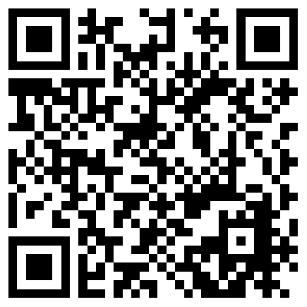
Registration
Flash the QR code to register for the
ERTMS 2022 Conference

Slide 15
Upcoming Free Webinar
23 March, 12.00-13.00 (Paris Time, CET - UTC+1)
Attracting Talent to the Railway Sector
Give us your feedback

